Slide 1
Food as Medicine:
Opportunities for Food Retail
Allison Yoder, MA, RDN, LD
Nutrition in Food Retail Program Development (NFRPD) Fellow
Notes:
Hi everyone, my name is Allison Yoder. I am a fellow through the Academy of Nutrition and Dietetics, focused in food retail nutrition program development.

Slide 2
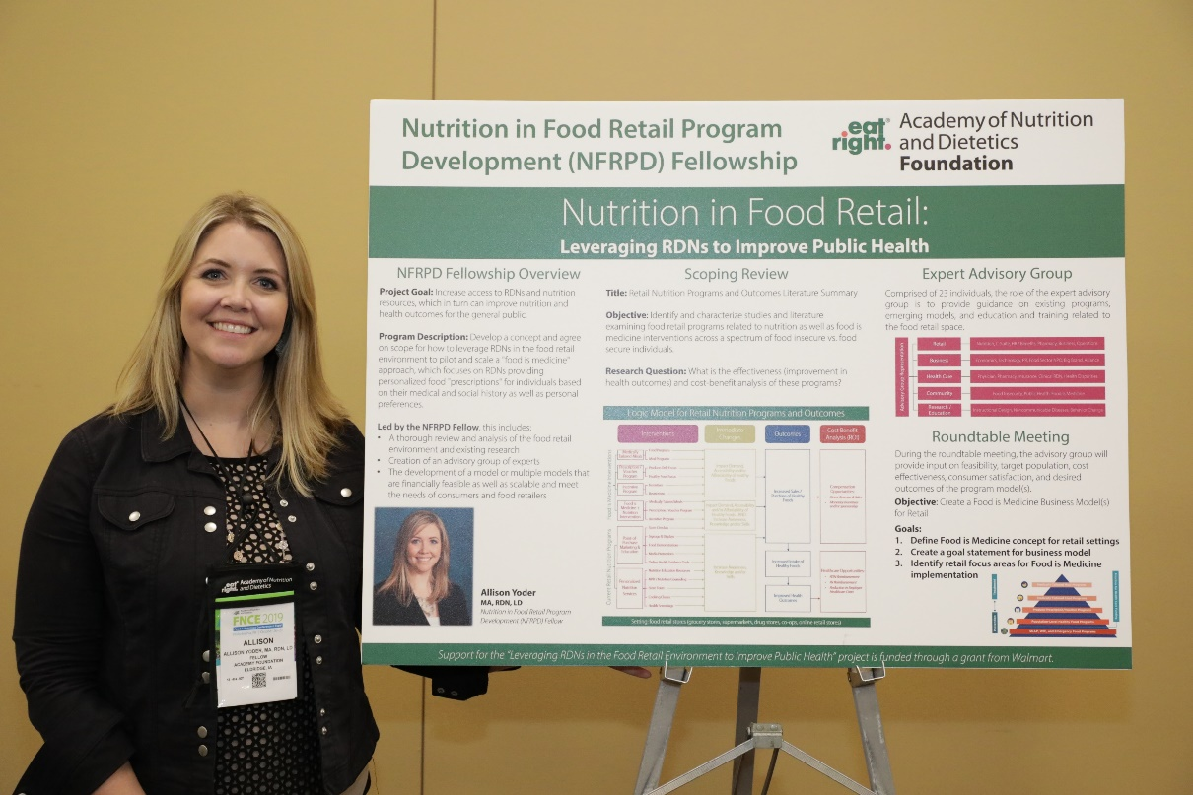
Nutrition in Food Retail (NFRPD) Fellowship
The Academy Foundation’s “Leveraging RDNs in the Food Retail Environment to Improve Public Health” kicked off in spring 2019. Support for this project was funded through a grant from Walmart.
Program Description:
Develop a framework for Food as Medicine within food retail that:
Defines Food as Medicine
Identifies potential pathways to intersect the role of RDNs within food retail
Provides recommendations for integrating Food as Medicine interventions within current retail nutrition models
Notes:
In 2019, the Academy Foundation received a grant from Walmart for a new project titled, “Leveraging RDNs in the Food Retail Environment to Improve Public Health”. I came on board in June of that year, and since then we’ve been looking at opportunities to integrate Food as Medicine interventions within current and future food retail nutrition programs. Through our research, we’ve developed a conceptual definition for Food as Medicine, we’ve identified pathways to intersect the role of Registered Dietitians within food retail settings, and we’ve provided recommendations to integrate Food as Medicine programs within current retail nutrition models.

Slide 3
Why Food as Medicine in Retail?
Top factors positively impacting sales and profits for food retailers:
Health and well-being
Leveraging food to manage / avoid health issues
Food retailers are critical allies in building momentum for Food as Medicine
Access to health services, particularly underserved populations
Omni-channel approach to deliver food and nutrition interventions
Structure allows for scalability of programs
Source: FMI’s Food Retailing Industry Speaks 2020 report
Notes:
So why are we focused on the concept of Food as Medicine within food retail settings?
According to the latest data collected in FMI’s Food Retailing Industry Speaks report, Health and Well-being and the Food as Medicine trend remain as top factors that are positively impacting sales and profits for food retailers. As health and well-being continues to thrive, we recognize that consumers are leading the charge in setting food and health trends, making food retailers critical allies in building momentum for Food as Medicine interventions.
The food retail environment is increasingly being used as an avenue for access to health services, particularly for underserved populations.
An omnichannel approach to the retail setting, including the physical store, digital nutrition solutions, and eCommerce/online shopping, provides a unique opportunity for RDNs to address gaps in health care equity by providing much-needed access points and the ability to connect consumers.
The structure of food retailers (having stores regionally as well as nationally, many in rural communities) as well as food retail nutrition programs (employing RDNs at the corporate, regional, and store levels) allows for the scalability of Food as Medicine programs.

Slide 4
NFRPD Expert Advisory Group
Advisory Group Chair: Sue Borra, RDN
Advisory Group:
21 individuals
3 Academy of Nutrition and Dietetics staff
Advisory Group Representation
Retail
Business
Health Care
Community
Research / Education
Nutrition, C-Suite, HR/Benefits, Pharmacy, Business, Operations
Economics, Technology, Public Relations, Food Sector NPO, Big Brand, Alliance
Food Insecurity, Public Health, Food is Medicine
Instructional Design, Noncommunicable Diseases, Behavior Change
Physician, Pharmacy, Insurance, Clinical RDN, Health Disparities
Notes:
As part of my Nutrition in Food Retail fellowship program, we assembled an expert advisory group, made up of 24 individuals who spanned diverse perspectives within the food retail and Food as Medicine professions, ranging from retail, business, health care, community, and research / education.
The advisory group convened at a 2-day roundtable meeting in November 2019 to determine how food retailers can implement a Food as Medicine concept within the food retail setting utilizing Registered Dietitians.

Slide 5
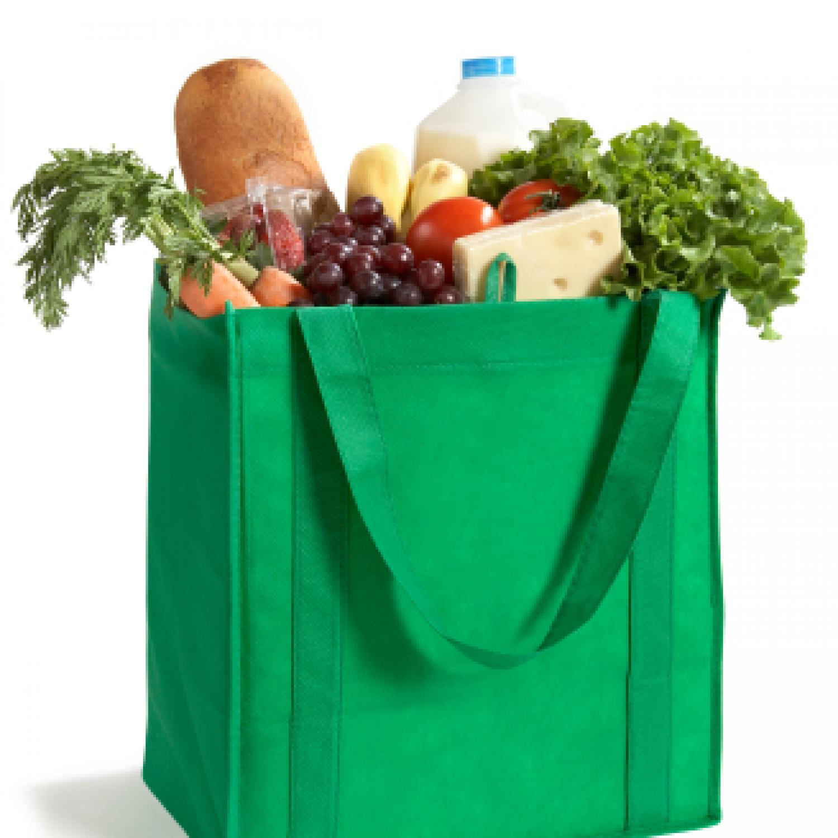
Food as Medicine in Food Retail
The concept of Food as Medicine includes three primary focus areas to support health through diet and nutrition:
Promote health and well-being
2) Disease management and treatment
3) Improve food safety and nutrition security
Notes:
This conceptual definition of Food as Medicine resulted from the roundtable meeting with three primary focus areas identified: 1) Food as preventative medicine to promote health and well-being; 2) Food as Medicine in disease management and treatment; and 3.) Food as Medicine to improve food safety and nutrition security. This conceptual definition is grounded in science to ultimately connect food to health in responsible and practical ways,

Slide 6
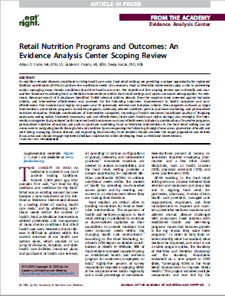
Scoping Review
8 Databases searched
211 studies met inclusion criteria
Analyzed landscape of food retail nutrition programs and Food as Medicine interventions
Assessed improvement in health outcomes and cost effectiveness
Notes:
Our Retail Nutrition Programs and Outcomes scoping review was recently published in the Journal of the Academy of Nutrition and Dietetics, and further supports the Food as Medicine definition and framework we’ve developed through the Fellowship program. Within the scoping review, we analyzed the landscape of food retail nutrition programs, as well as Food as Medicine interventions to get a better idea of what types of programs were out there. We also wanted to take a deeper dive to see which types of programs had an improvement in health outcomes while also producing a positive return on investment.

Slide 7
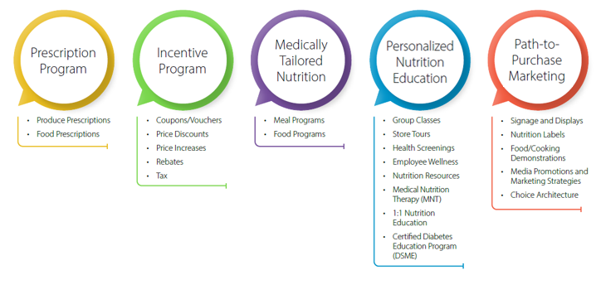
Food as Medicine Program Models
Notes:
Within the context of the scoping review, five program model categories were identified: Prescription Programs, Incentive Programs, Medically Tailored Nutrition, Path-to-Purchase Marketing and Personalized Nutrition Education.
Prescription Program:
A prescription program operates like a traditional prescription, allowing dietitians and other health professionals to prescribe subsidized food.
Incentive Program:
Food incentive programs can range from providing coupons and vouchers to discounted pricing on food categories (such as fruits and vegetables), rebates (in the form of cash incentives and discount coupons) and disincentives, such as taxes on certain food items.
Medically-Tailored Nutrition:
Medically-tailored nutrition provides a more comprehensive therapy for patients who could benefit from improved nutrition. With this model, a RDN or other health care provider writes a prescription for the patient to receive tailored meals or boxes of food that align with a patient’s health condition or diagnosis, such as diabetes.
Path-to-Purchase Marketing
Path-to-purchase marketing includes program models that are designed to produce behavior change as well as environmental change at the location where selection of food-for-purchase occurs.
Personalized Nutrition Education
Personalized nutrition education includes individualized approaches to health and well-being that engage dietitians and nutrition resources directly with the consumer, both in-person and virtually, resulting in positive behavior changes.

Slide 8
Scoping Review Key Findings
1. Food as Medicine interventions in the retail setting produce successful outcomes
Increased Sales and Revenue
Path-to-Purchase Marketing
Incentive Programs
Positive Behavior Change (healthier shopping purchases and improved eating habits)
Personalized Nutrition Education
Notes:
The scoping review resulted in four key findings. First, we found that Food as Medicine interventions in the retail setting are shown to be successful in producing either positive health outcomes or cost-effectiveness as single category interventions. Path-to-purchase marketing, as well as incentive programs produced the most positive outcomes as stand-alone program models in terms of increased sales and revenue. However, personalized nutrition services also contributed in producing positive behavior change through healthier shopping purchases and improved eating habits.

Slide 9
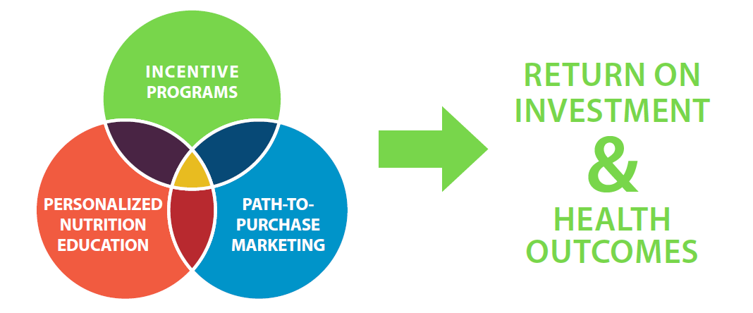
Scoping Review Key Findings
2. Both return-on-investment (ROI) and improved health outcomes were achieved through multiple category interventions.
Notes:
Our second key finding shows that both ROI for the retailer and improved health outcomes for program participants were also achieved when multiple category interventions were implemented. Studies that demonstrated the most effectiveness with producing both health outcomes and return-on-investment for the retailer included a combination of program models: 1.) incentive programs (including prescription programs and medically-tailored meals combined with an incentive program), 2.) personalized nutrition services, and 3.) path-to-purchase marketing
While several of these categories produced positive outcomes as stand-alone program models, it is important to note that the greatest opportunity to integrate food as medicine with existing and future retail nutrition programs were shown through multiple category program models.

Slide 10
Scoping Review Key Findings
3. Food as Medicine retail focus areas:
Promotion of Health and Well-being
Management of Chronic Disease
Improved Food and Nutrition Security
4. Registered Dietitian Nutritionists
Mostly involved in personalized nutrition education categories within retail settings
Often utilized as part of an integrated team of professionals
Notes:
The third key finding supported the foundation for which we built the conceptual definition from. Food as Medicine interventions as well as retail nutrition programs encompass three different focus areas: food as preventive medicine in the promotion of health and well-being, food as medicine in the management of chronic disease and food as medicine to improve food and nutrition security.
Our last key findings found that RDNs are mostly involved in personalized nutrition education categories within retail settings (either as single strategy or multi-component interventions) and are often utilized as part of an integrated team of professionals that includes physicians, nurses, pharmacists, and chefs.

Slide 11
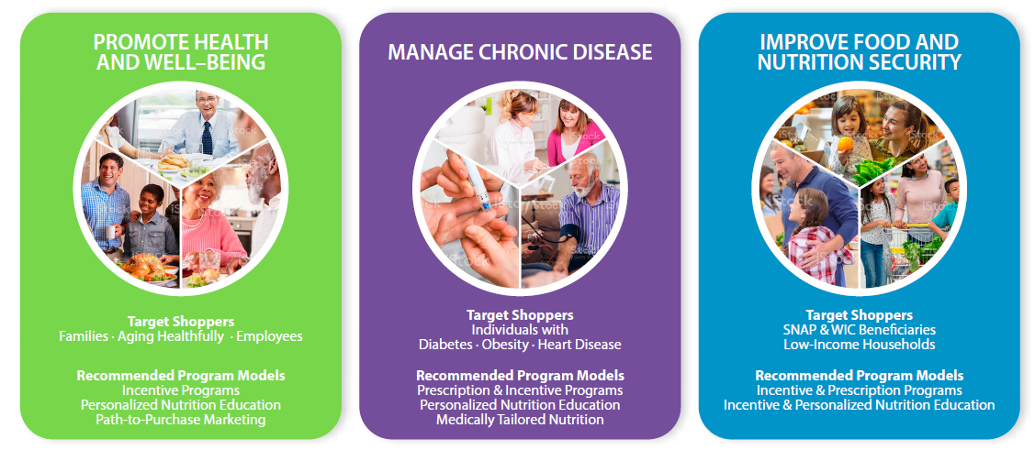
Food as Medicine Retail Nutrition Framework
Notes:
Finally, as a result of both the outcomes from the advisory group roundtable meetings, as well as key findings from the scoping review, a Food as Medicine Retail Nutrition Framework was developed. Through this framework, services, programs, and promotions can be developed to meet the unique needs of retailers based on their current health and well-being priorities. Having an understanding of target shoppers and how they fit within food as medicine focus areas, will allow retailers to be better positioned and able to leverage product selection, marketing strategies and services.
This framework also highlights recommended Food as Medicine program models to implement within each focus area. For example, if you’re trying to promote health and well-being, and you’re wanting to target families, you should consider a combination of incentive programs, personalized nutrition education and path-to-purchase marketing. For a family meals promotion, a food retailer may want to consider having meal solution resources available at the point of purchase, whether that be in-store or on your website or eCommerce site. And then pair this with Telenutrition visits with a Registered Dietitian or a Dietitian live chat feature on their eCommerce site, along with pre-made meal solutions that correspond with their weekly ad, or feature items on sale.
As you can see, the combination of programs and incentives is endless, and can be completely tailored to the needs and priorities of each food retailer.

Slide 12
Food as Medicine Retail Nutrition Framework
Landscape of retail health and well-being
Implications for Food as Medicine within retail
Food as Medicine Retail Nutrition Framework
Focus Areas
Target Shoppers
Recommended program models
Key elements of success
Current Food as Medicine retail models
Notes:
To build upon the Retail Nutrition Framework, a white paper is available for download on the Academy Foundation’s website. Within the paper, we go into more detail outlining the current landscape of retail health and well-being and implications for Food as Medicine programs, including focus areas, target shoppers and recommended program models. The paper also outlines key elements of a successful retail Food as Medicine program, and highlights current Food as Medicine retail models.

Slide 13
Additional Resources We’re Working On
Food Insecurity Webinar
Food as Medicine Retail Nutrition Video
Retail Nutrition Evaluation Toolkit
Pilot Opportunities with Food Retailers
Retail Nutrition Certificate of Training Program
Retail Nutrition Dietetic Internship Curriculum
Notes:
We also have several resources we’re currently working on with the fellowship program to further support Food as Medicine programming, and the value that Registered Dietitians bring to the table leading these efforts.
A Food Insecurity Webinar recording is available on the Academy Foundation’s website. During the webinar, we focus on resources available to assist with food and nutrition security benefits, and strategies on how RDNS can further support their customers.
A Food as Medicine Retail Nutrition Video is also on the Academy Foundation’s website, marketing the Food as Medicine framework that was developed.
We’re currently working on an evaluation toolkit aimed at retail nutrition programs, and will be conducing pilot opportunities with retailers soon to evaluate outcomes of Food as Medicine program models.
And lastly, we’re continuing to focus on supporting the skills and knowledge of retail dietitians through additional training opportunities, including a certificate of training program for current dietitians and dietetic internship curriculum for future dietitians.

Slide 14
Allison Yoder
ayoder@eatright.org | 563-349-9498
Notes:
I’ve included my contact information here. Please don’t hesitate to reach out to me if you like to chat more about Food as Medicine and the Academy Foundation Fellowship program.

