Slide 1


Nutrition Security
Embracing solutions that nourish the nation
National Strategy on Food:
The Next Farm Bill
Parke Wilde
Friedman School of Nutrition Science and Policy
Tufts University

Slide 2
Outline
The Thrifty Food Plan (TFP) and the cost of healthy food.
SNAP healthy incentives.
Nutrition security and food security.

Slide 3
Outline
The Thrifty Food Plan (TFP) and the cost of healthy food.
SNAP healthy incentives.
Nutrition security and food security.

Slide 4
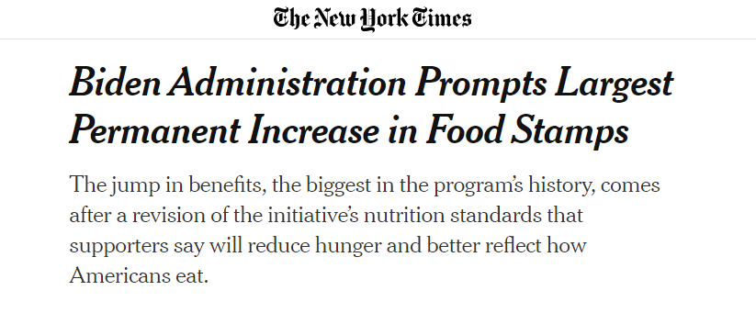
Source: New York Times, August 2021

Slide 5
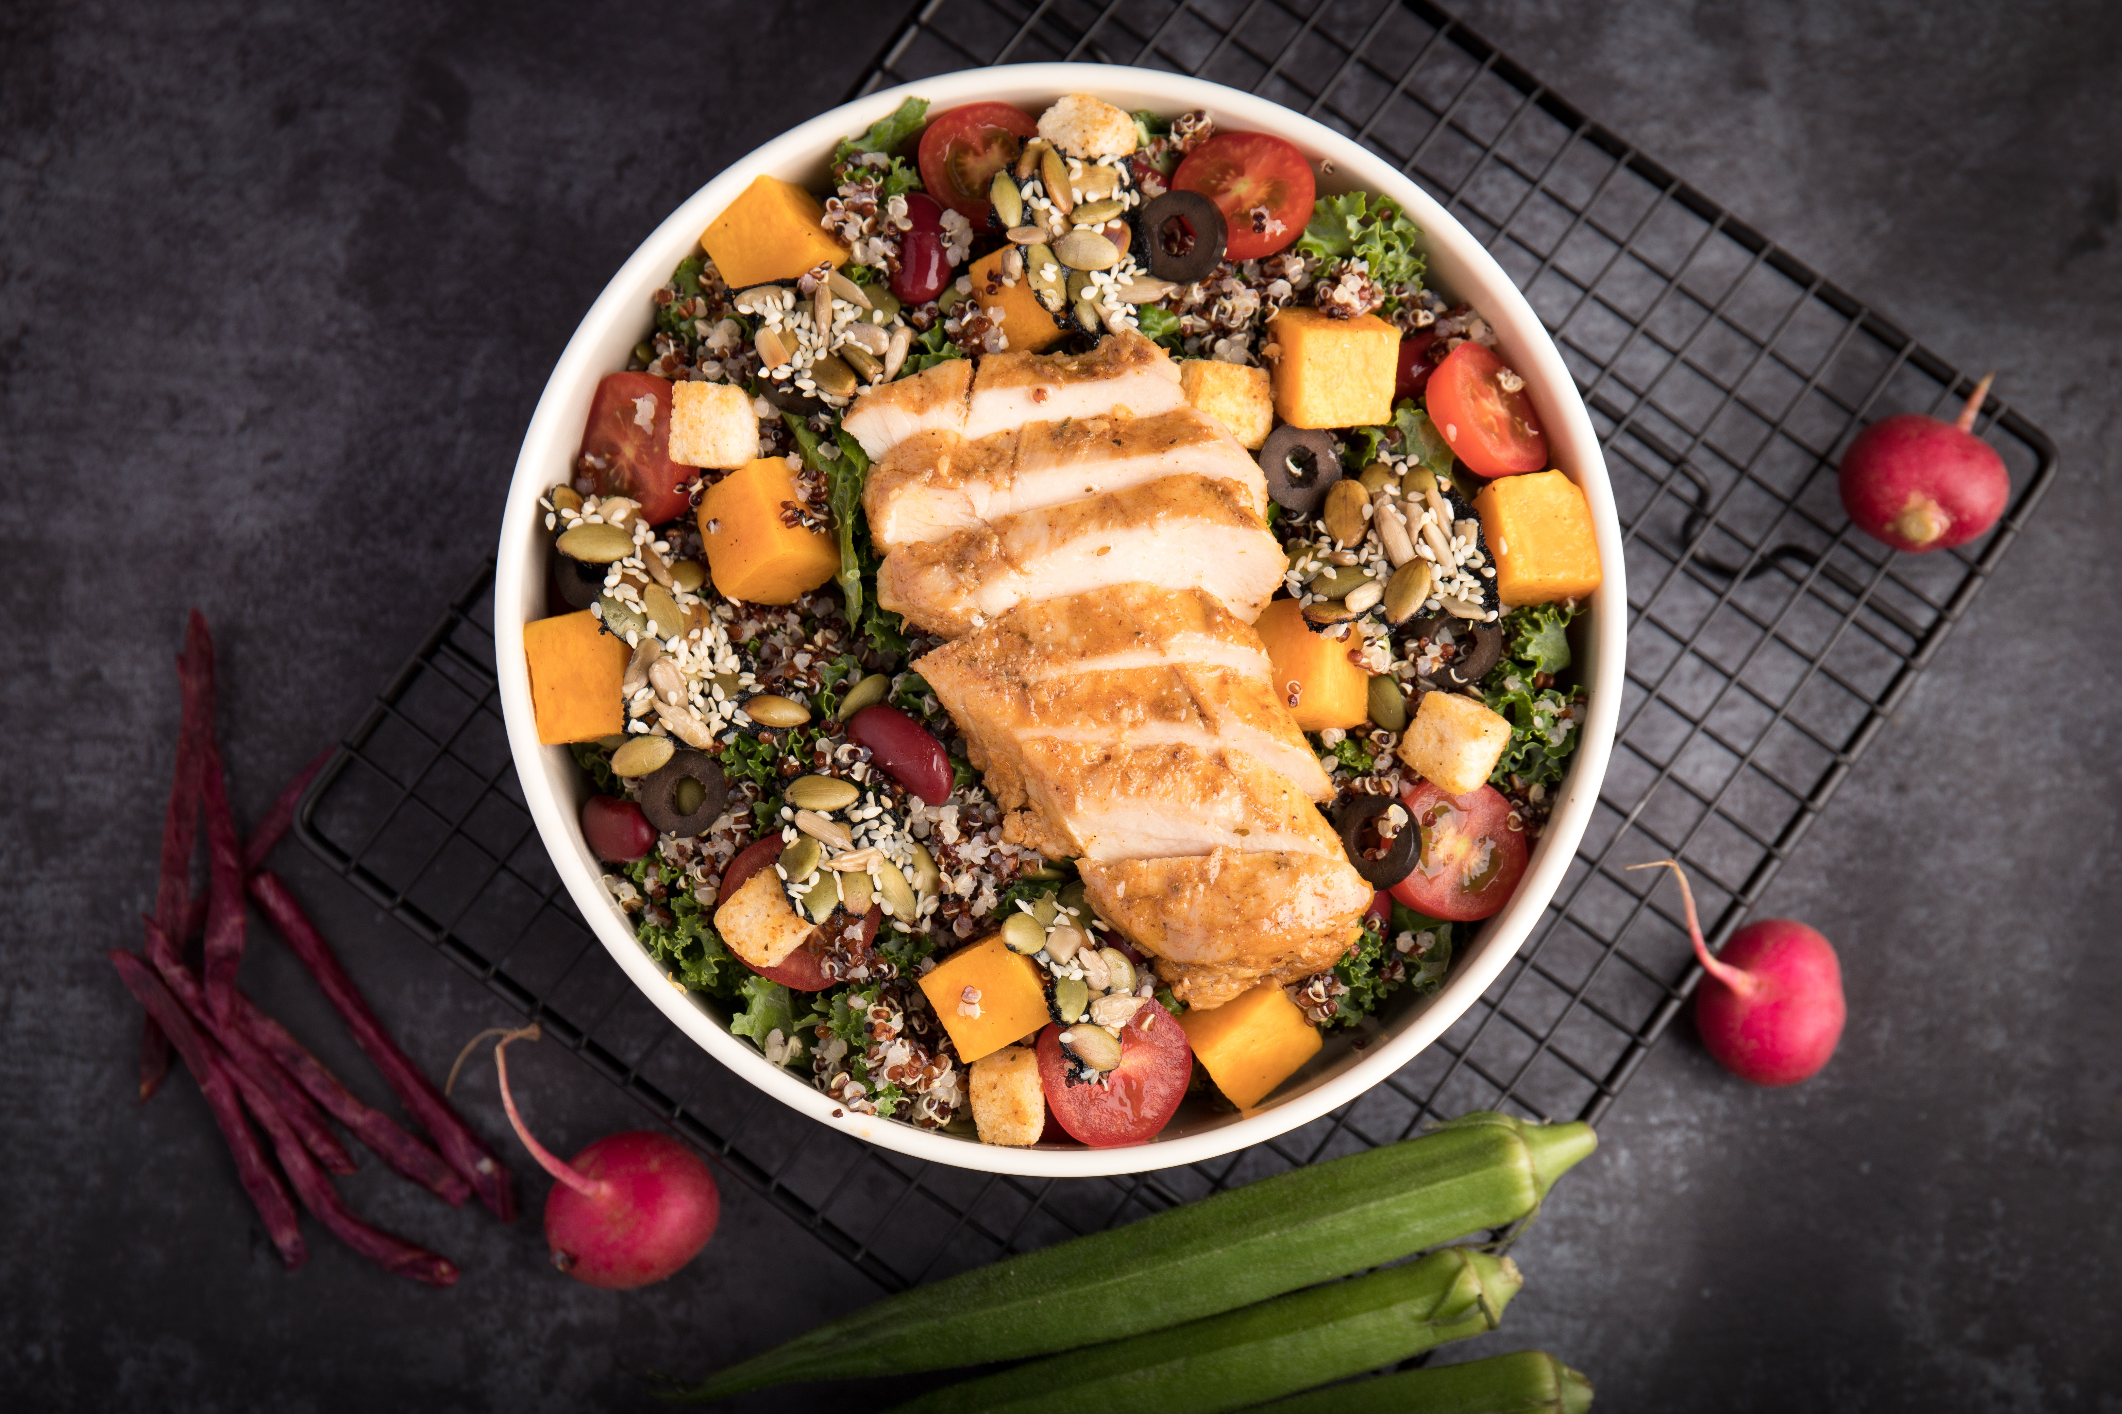

More healthy
More occasional
Less expensive
More expensive
Notes:
VERSION 4 – up arrow to More Healthy
Possible title: The Four Quadrants of Diet: Measuring Healthfulness and Cost
Images:
Turkey Tacos picture: Cooking Matters website: https://cookingmatters.org/recipes/turkey-tacos
French fries: FRIES_pexels-dzenina-lukac-1583884.
Salad with chicken: pexels-kei-photo-2741448
Steak: Powerpoint Images collection (searchword: Steak)

Slide 6
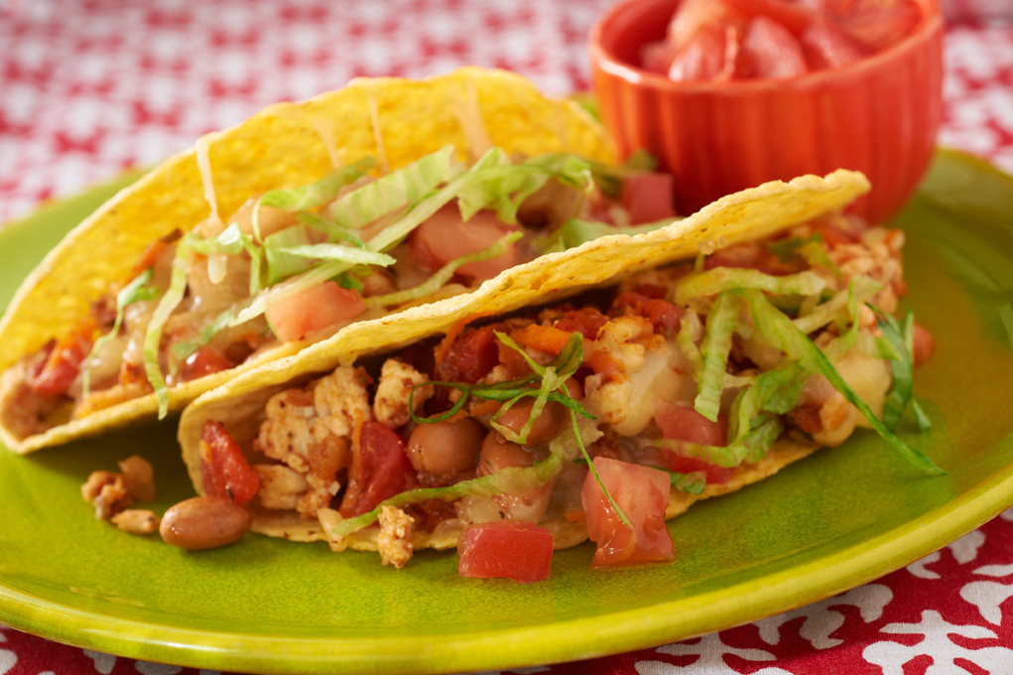

More healthy
More occasional
Less expensive
More expensive
Notes:
VERSION 4 – up arrow to More Healthy
Possible title: The Four Quadrants of Diet: Measuring Healthfulness and Cost
Images:
Turkey Tacos picture: Cooking Matters website: https://cookingmatters.org/recipes/turkey-tacos
French fries: FRIES_pexels-dzenina-lukac-1583884.
Salad with chicken: pexels-kei-photo-2741448
Steak: Powerpoint Images collection (searchword: Steak)

Slide 7
Optimization in the TFP
Choose a plan (123 category quantities in our case):
Not too different from current intake (quadratic objective function)
Meeting constraints:
  Cost and food energy
  Nutrients from the Dietary Guidelines 2020-2025
  Broad food categories from MyPlate
  Practicality constraints

Slide 8
Choice of constraints → estimated cost.
Source: Wilde and Llobrera (2009).

Slide 9
Insights about TFP models
Easier to meet nutrient constraints than food group constraints
Expectations for fruits, vegetables, and protein foods matter
Strict or more feasible sodium constraint
Interaction of constraints and aspirations

Slide 10
Outline
The Thrifty Food Plan (TFP) and the cost of healthy food.
SNAP healthy incentives.
Nutrition security and food security.

Slide 11
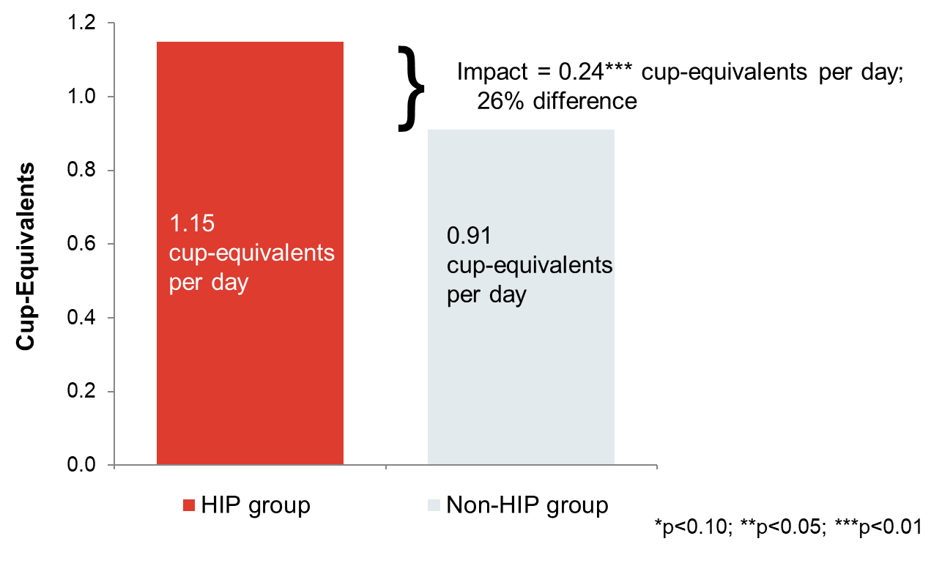
HIP: daily fruit and vegetables
Source: Bartlett et al. (2015)

Slide 12
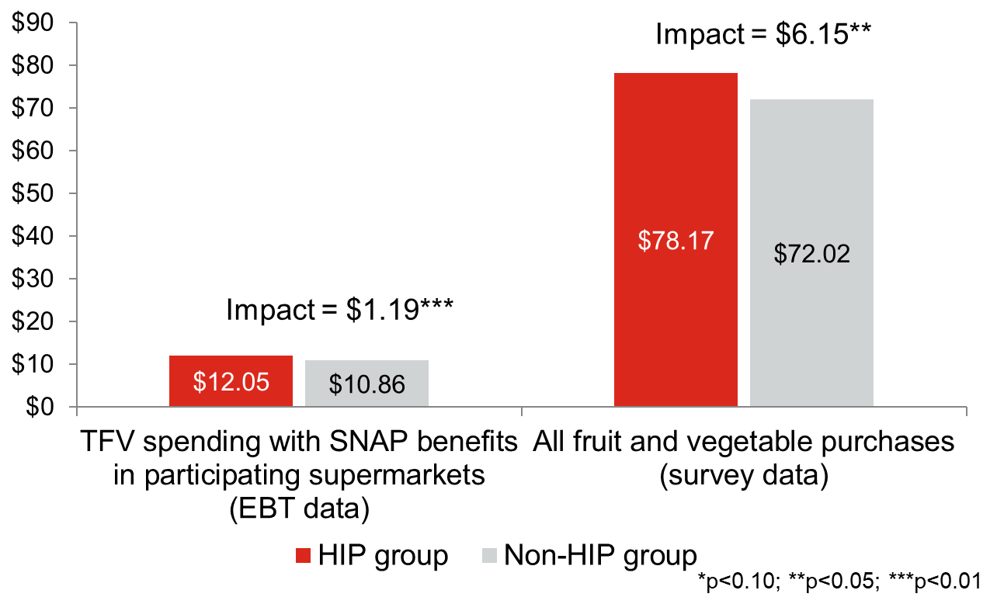
Monthly fruit and vegetables ($)
Source: Bartlett et al. (2015)

Slide 13
FINI Evaluation Report
Awareness higher among those who had shopped there before FINI
Positive impact on average monthly FV expenditures for those in the farmers market shopper, grocery store shopper, and grocery store general intervention groups
“Further research is needed to examine
  (1) effective messaging strategies to increase incentive awareness and
  (2) the long-term impact of incentives on FV expenditures.”
Source: Vericker et al., Journal of Nutrition Education and Behavior (2021)

Slide 14
A promotions experiment
Table 6.3. SNAP incentive digital promotions campaign impact on shopping patterns and sales
Source: Sara John dissertation (2021)

Slide 15
A promotions experiment
Table 6.3. SNAP incentive digital promotions campaign impact on shopping patterns and sales
Source: Sara John dissertation (2021)

Slide 16
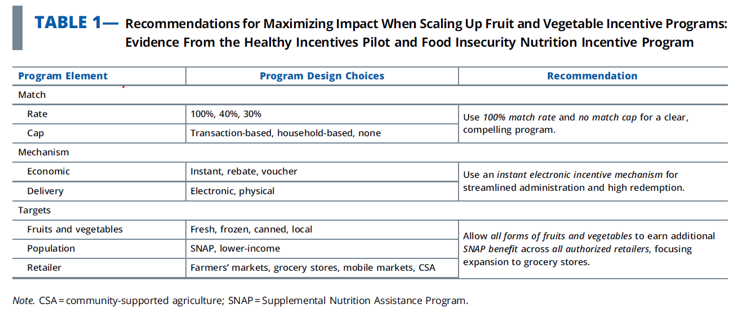
AJPH Editorial (2021)
Source: Sara John et al., American Journal of Public Health (2021)

Slide 17
Outline
The Thrifty Food Plan (TFP) and the cost of healthy food.
SNAP healthy incentives.
Nutrition security and food security.

Slide 18
Nutrition security and food security
Mozaffarian, Fleischhacker, Andrés, JAMA (2021)
The Need to Shift From Food Insecurity to Nutrition Security
Although the strict definition of food security includes access to and availability of nutritious foods, in practice, the dimension of nutrition has often been overlooked or disregarded, with associated adverse consequences.

Slide 19
Notes:
CMB updated 2014

Slide 20
Notes:
CMB updated 2014

Slide 21
Notes:
CMB updated 2014

Slide 22
Notes:
CMB updated 2014

Slide 23

April 4: Food Sec 25 event
25 Years of Food Security Measurement
https://sites.tufts.edu/foodsec25/

