Slide 1
Welcome, the HOW Symposium will begin soon!

Slide 3
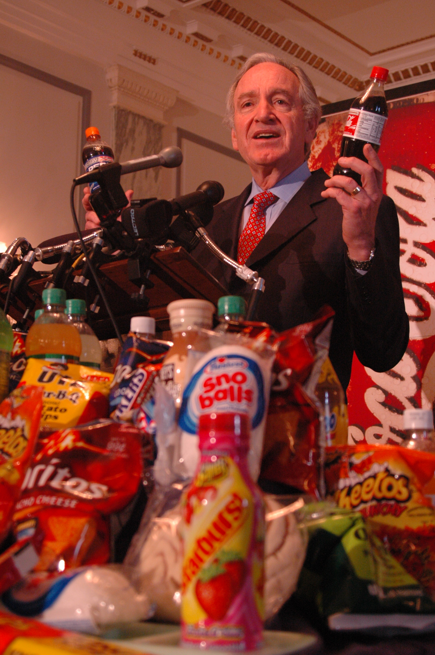

Slide 5
Title
Slide content
Slide content
Slide content

Slide 6
Is there a path for healthy and sustainable diets for all?
Walter C. Willett, MD, DrPH
Department of Nutrition, Harvard T. H. Chan School of Public Health

Slide 7
Break

Slide 8
Moderator: Liz Garst
Chris Jones, University of Iowa
Jean Bertrand Contina, Rodale Institute
Kamyar Enshayan, University of Northern Iowa
Audrey Tran Lam, University of Northern Iowa
Panel One:
Sustainable Food Production

Slide 9
Ethanol Needs to Die
Chris Jones, Research Engineer, IIHR Hydroscience and Engineering
Slides Available at: https://cjones.iihr.uiowa.edu/

Slide 10
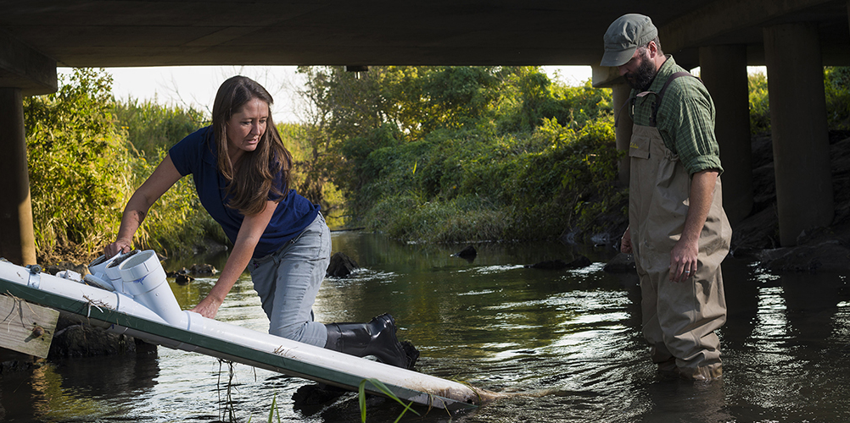
IIHR Water Quality Sensor Network

Slide 11
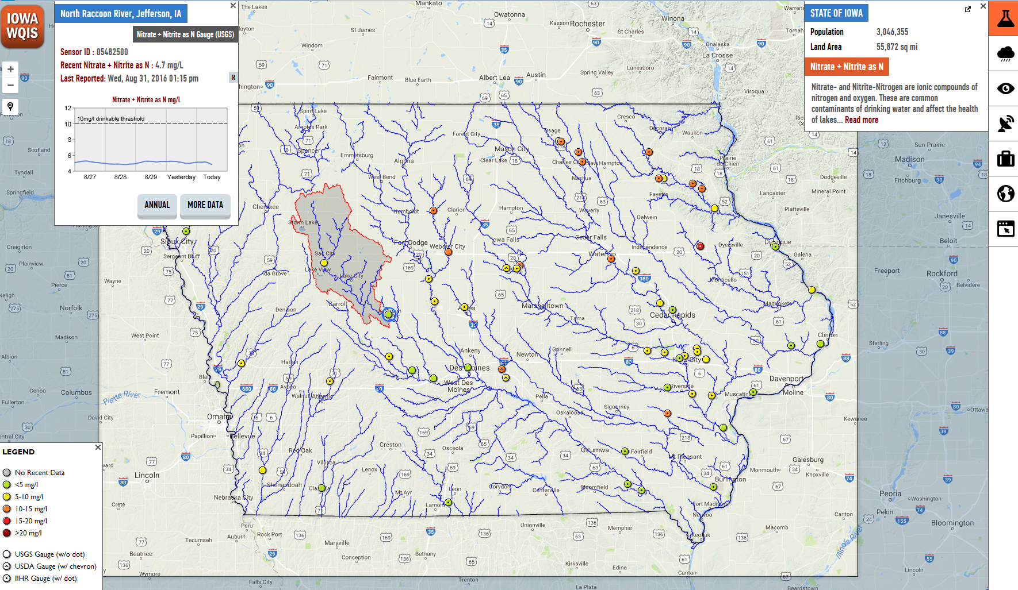
Iowa Water Quality Information System
iwqis.iowawis.org/
http://iwqis.iowawis.org/app/?datetime=2017-06-06T13:00

Slide 12
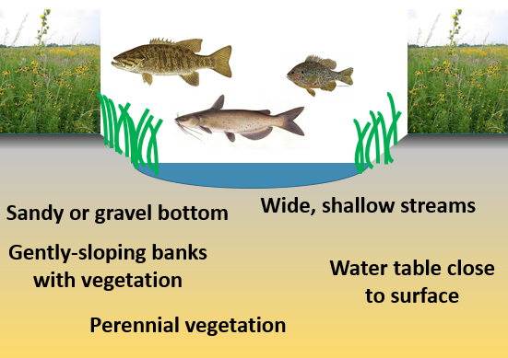
Pre-European Settlement Streams

Slide 13
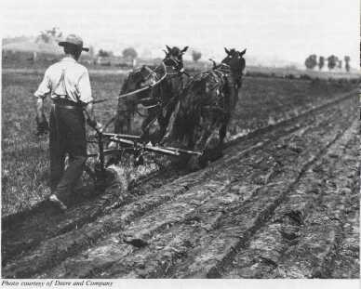
Breaking the prairie

Slide 14
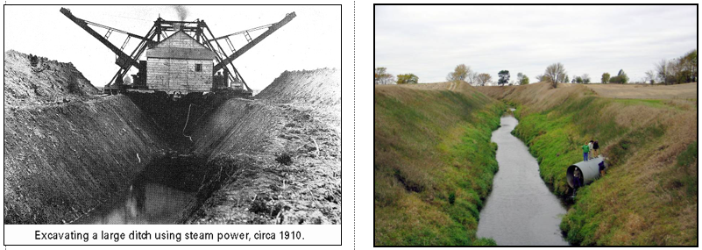
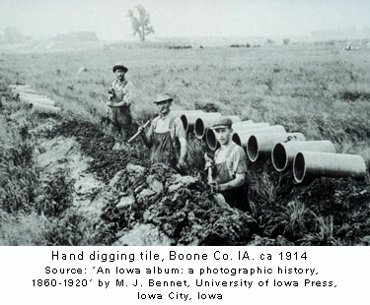
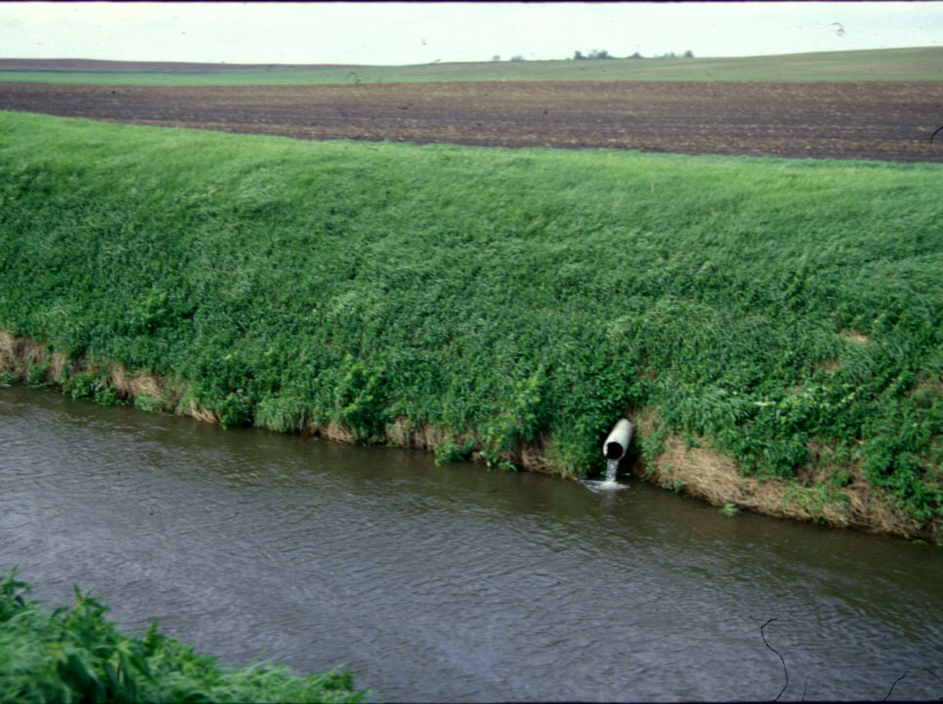

Slide 15
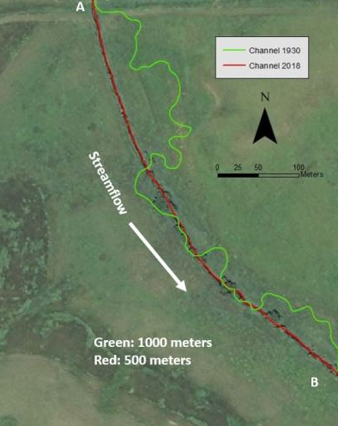
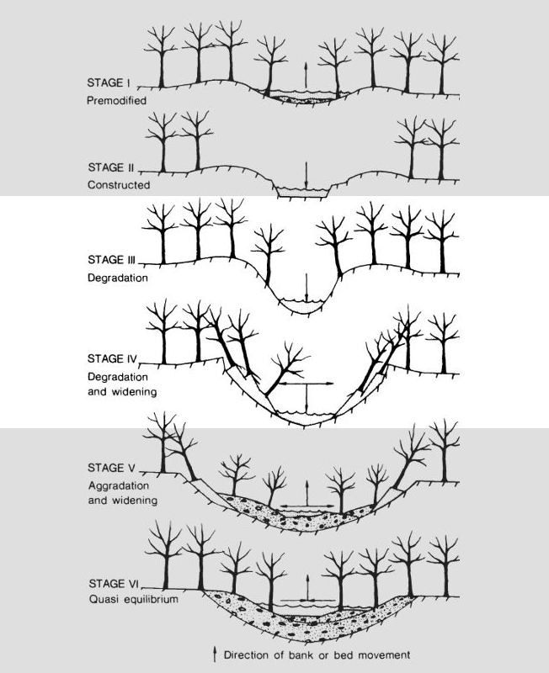
Stream Straightening, 1930-1975

Slide 16
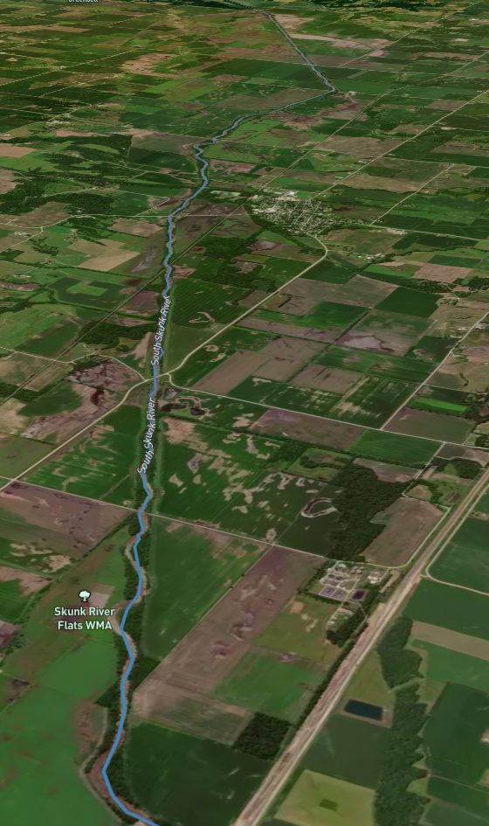
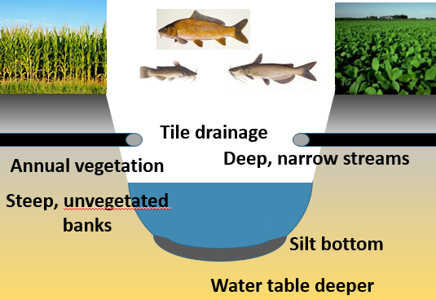
Modified Streams

Slide 17
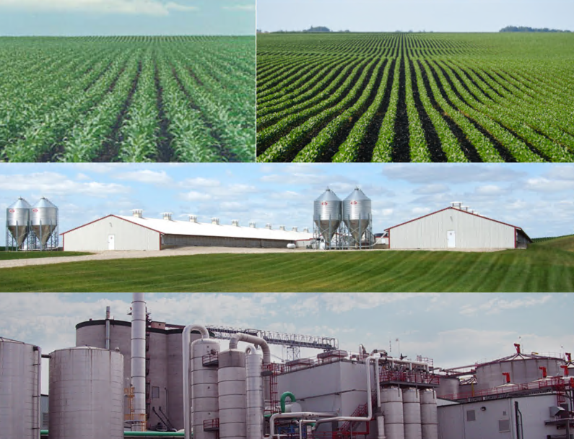

Slide 18
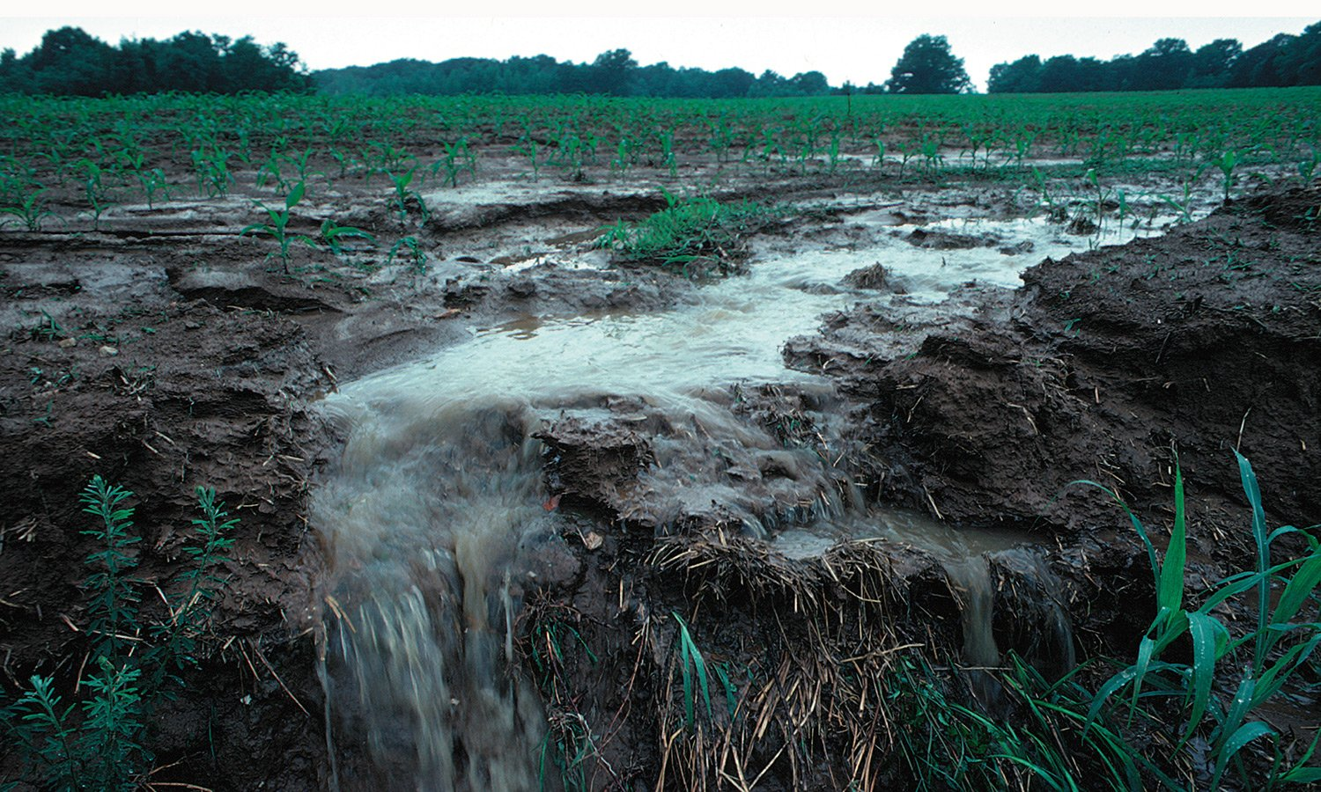
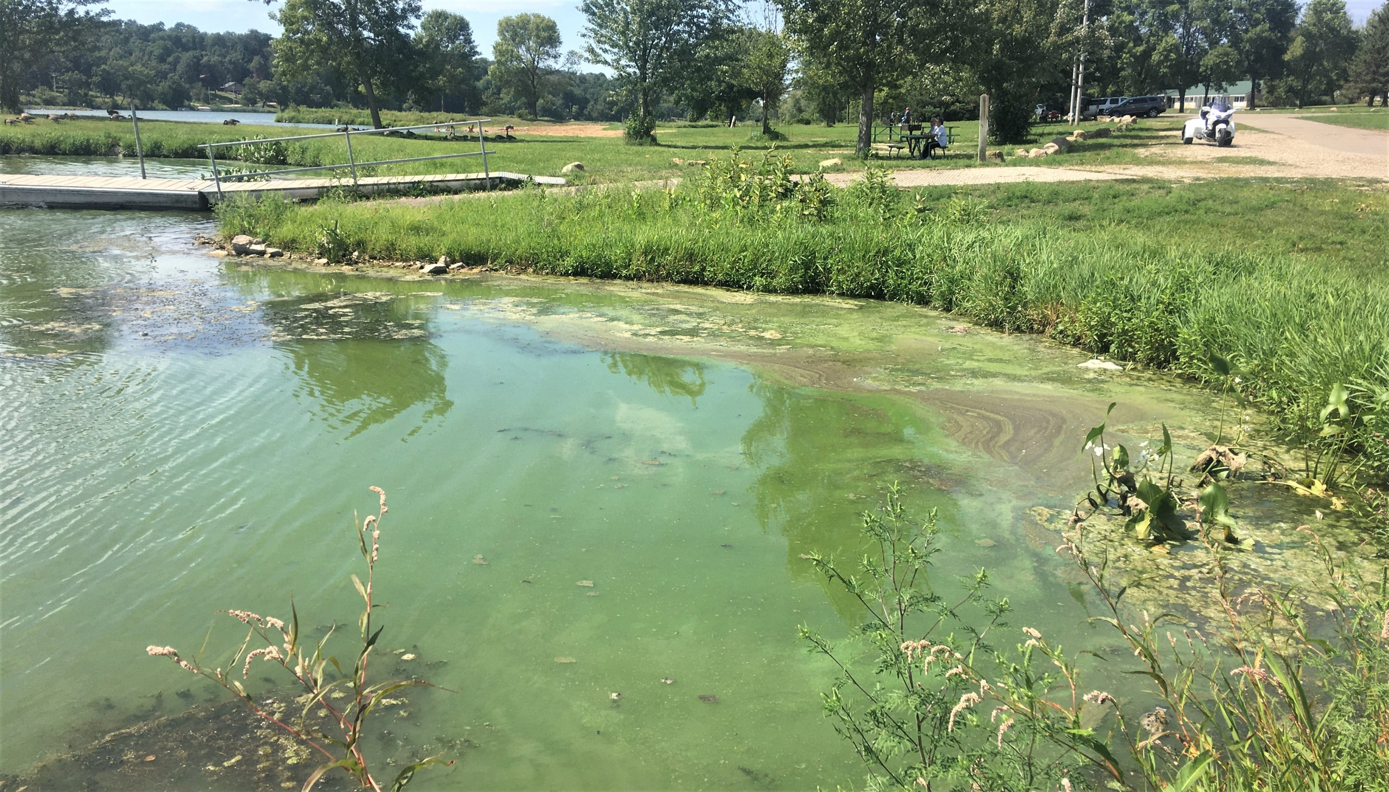
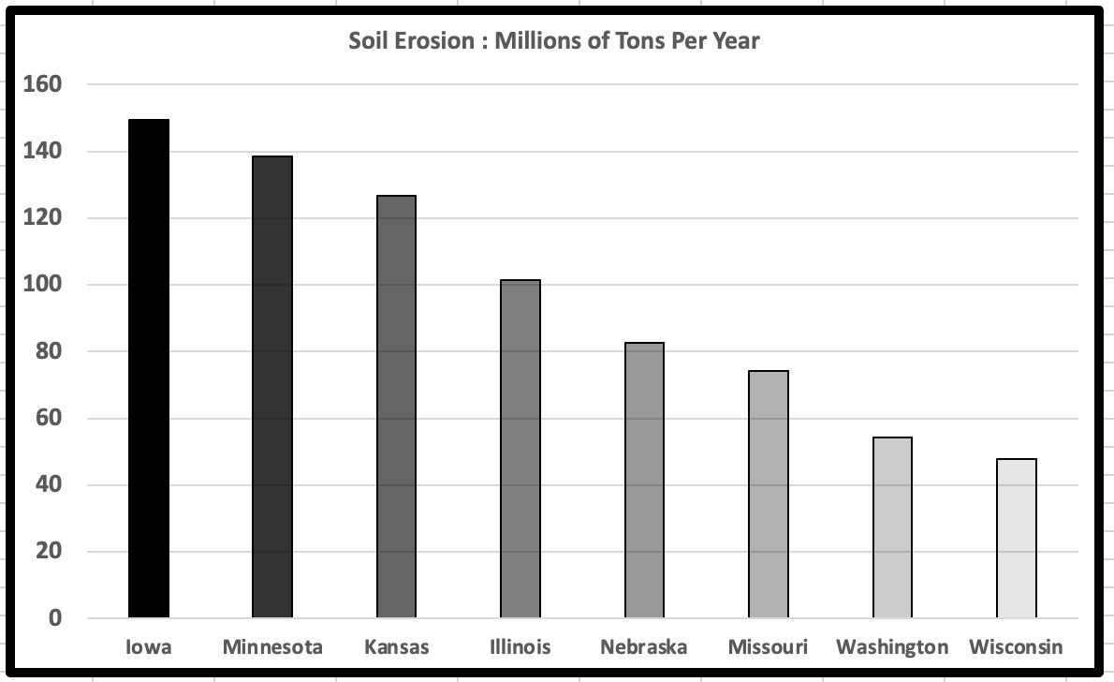
Water Quality Consequences
Iowa contributes:
  55% of the nitrate in the Missouri River (3.3% of the area)
  45% of the nitrate in the Upper Mississippi River (21% of the land)
  29% of the nitrate and 15% of phosphorus at the Mississippi outlet (4.5% of the land)

Slide 19
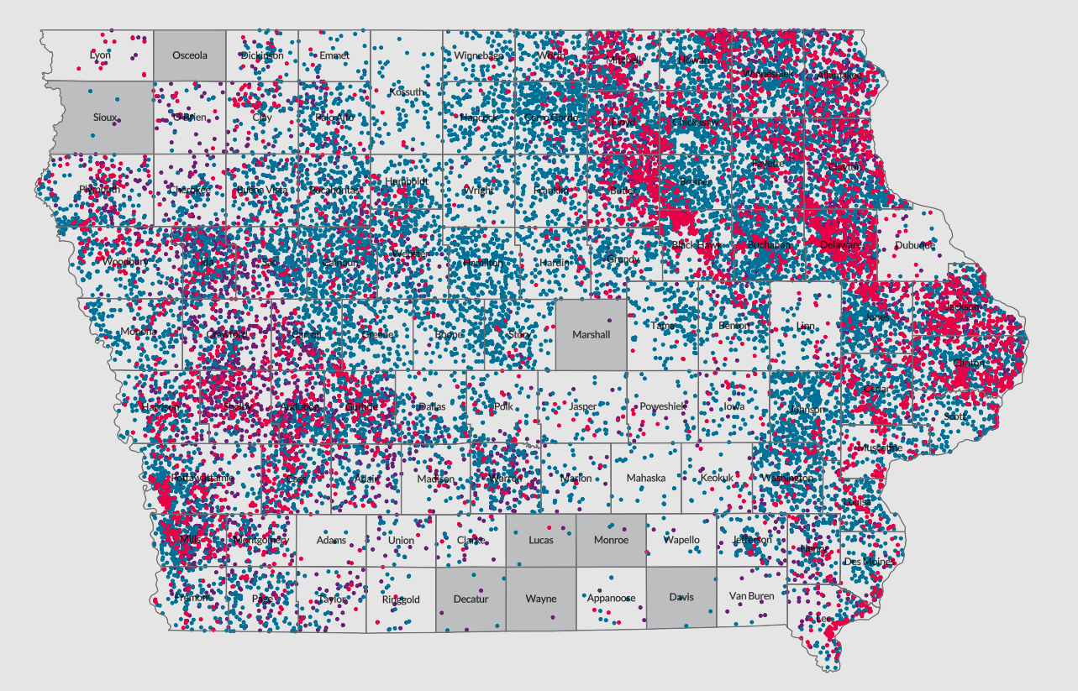
Drinking Water
7000 private wells have tested above the safe drinking water level of 10 mg/L nitrate since 2000
1/3 of Iowa’s Public Water Supplies are vulnerable to nitrate contamination
60 PWSs are removing nitrate
25% of Iowa drink water that has been treated for nitrate reduction

Slide 20
Problem of Scale
70% of land in corn-soy rotation
11,000 square miles used for ethanol production
25 million hogs
4 million beef cattle
80 million laying chickens
5 million turkeys
4 million broiler chickens
220,000 dairy cows

Slide 21
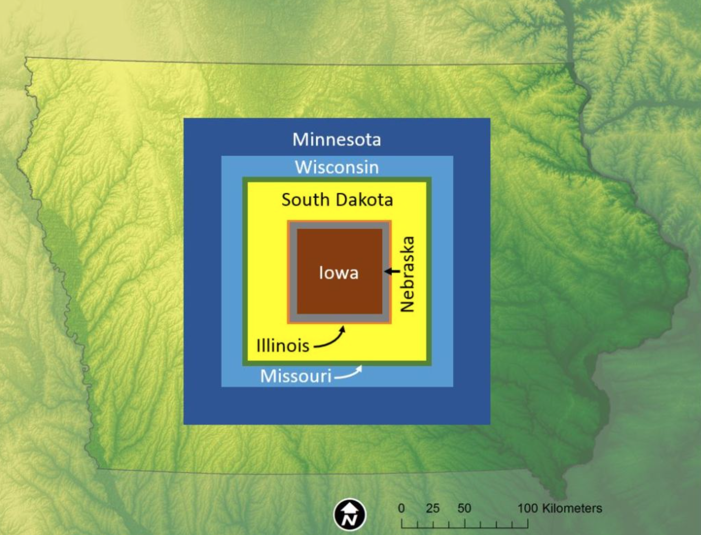

Slide 22
Economics of N loss
Cost of Nitrogen: today about $0.86/lb
Cost to remove nitrogen using BMPs: $2-$10/pound
Average statewide load: 600 million lbs
45% reduction = 270 million lbs/year
$540M to $2.7B/year

Slide 23
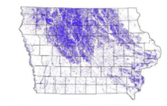
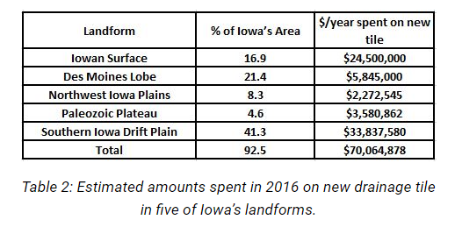
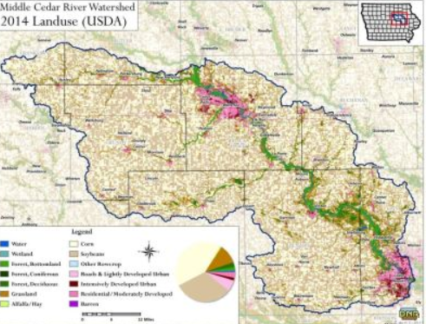
2 million miles of tile in Iowa
1200 miles new tile/year!

Slide 24
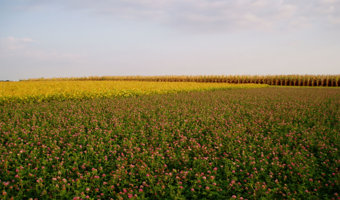

How Do You Overcome Structural Drivers to Bad Water Quality?
More Diverse Farming Systems
Marsden Long Term Rotation Study-ISU
Corn/Soybean/Oats/Alfalfa/Alfalfa vs Corn/Soybean
Matt Liebman
N fertilizer use 91% lower
Herbicide use 97% lower
Weed biomass similar
Soybean sudden death syndrome much lower
Soil health is better
Tile nitrate 57% lower
Soil erosion 50% lower
Fossil Fuel use 60% lower
Net returns similar (revenue lower but input costs also lower)

Slide 25
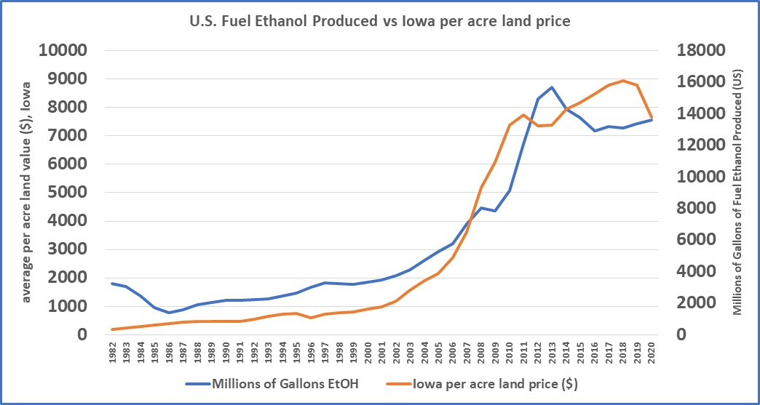
Fuel Ethanol
Calories from corn used to produce fuel ethanol exceed the caloric requirements of the entire US population!

Slide 26
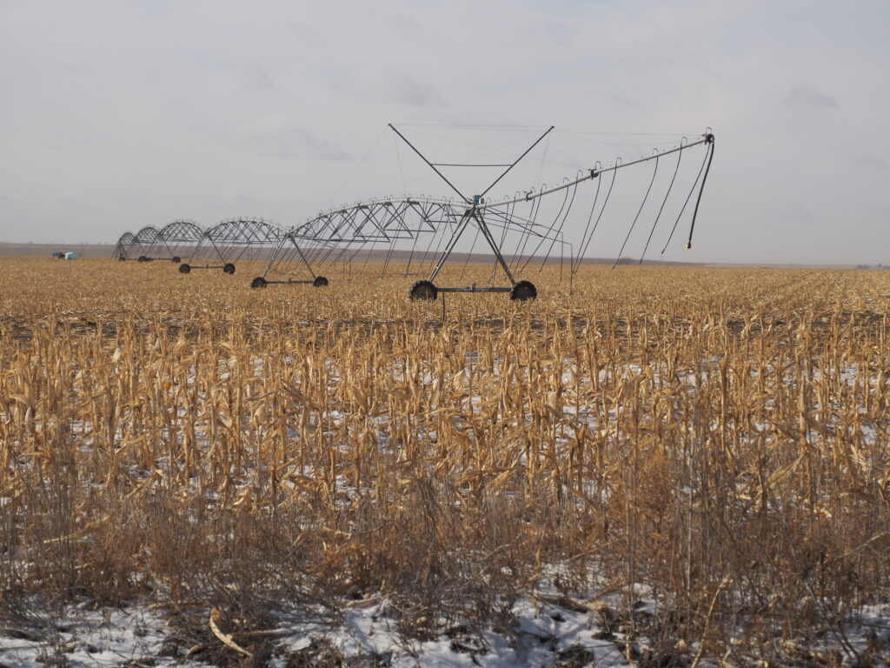
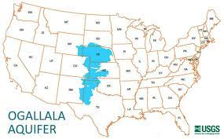
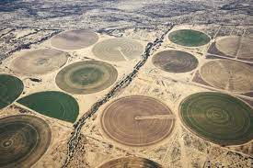
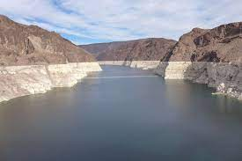
Ethanol creates perversity in US Agriculture
Corn Grown in Arid Areas for Ethanol and Livestock
6000 years to naturally replenish
Irrigated Alfalfa Uses ½ of the Colorado River
Exported to China, Saudi Arabia, etc.

Slide 27
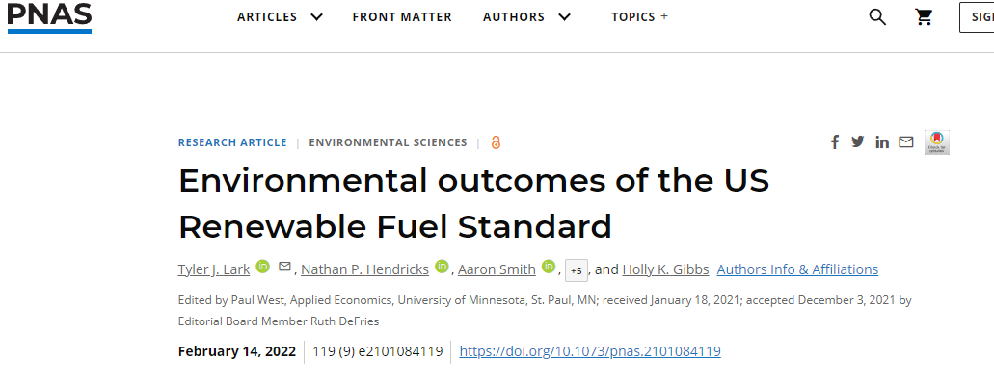
Increased corn acres 8.7%
Increased total crop area 2.4%
Increased fertilizer use 3-8%
Increased water quality degradants 3-5%
Increased GHG emissions 24%

Slide 28
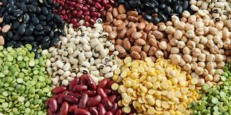
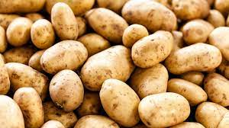
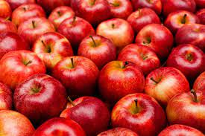
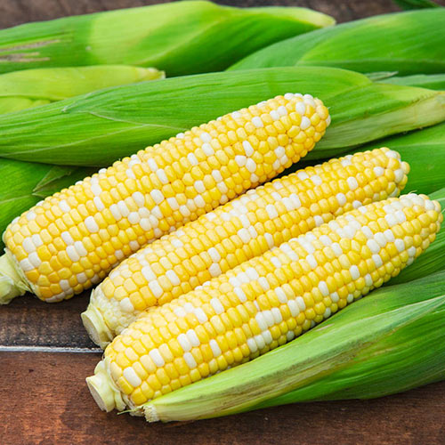
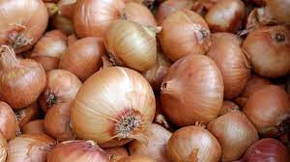
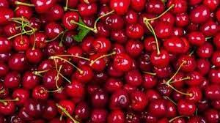
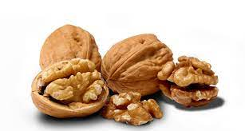
What could we do with 11,000 square miles (7 million acres)?
1.1 million acres: grow enough dried beans for every person in the U.S.
360,000 acres: grow enough potatoes for every person in the U.S.
220,000 acres: grow enough apples for every person in the U.S.
150,000 acres: grow enough canned sweet corn for every person in the U.S.
140,000 acres: grow enough onions for every person in the U.S.
37,000 acres: grow enough cherries for every person in the U.S.
26,000 acres: grow enough walnuts for every person in the U.S.
5 million acres still left!

Slide 29
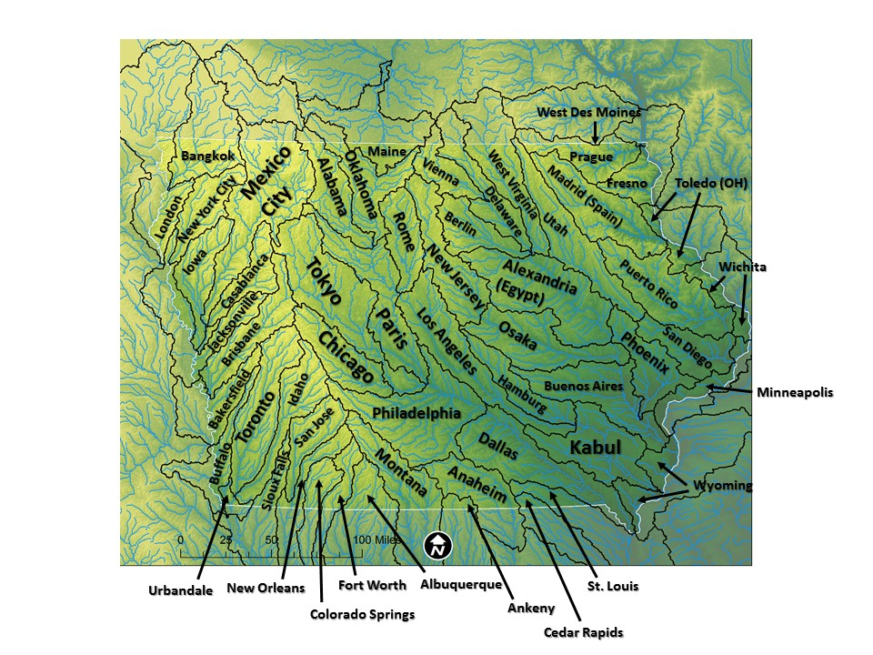

Slide 30

https://cjones.iihr.uiowa.edu/

Slide 31

Reimagining Sustainable Food Production: Perspectives from Regenerative Organic Practices
Jean Bertrand Contina¹, Ph.D. and Andrew Smith², Ph.D.
¹Research Director; ²Chief Operating Officer
jean.contina@rodaleinstitute.org; andrew.smith@rodaleinstitute.org

Slide 32
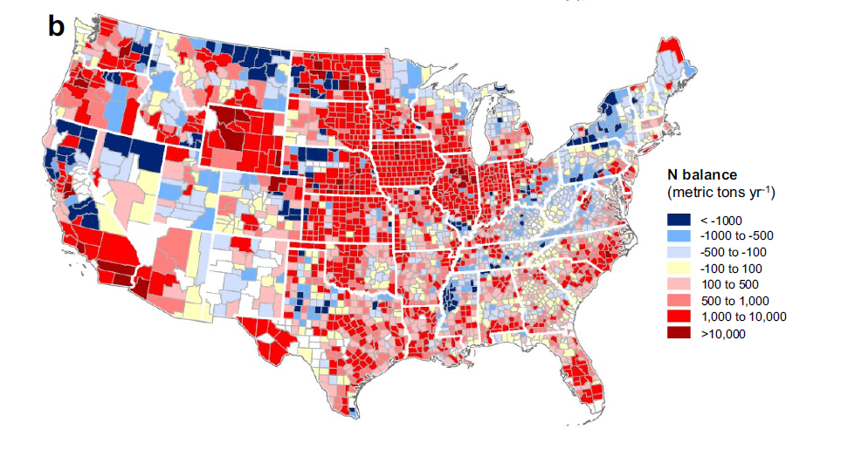
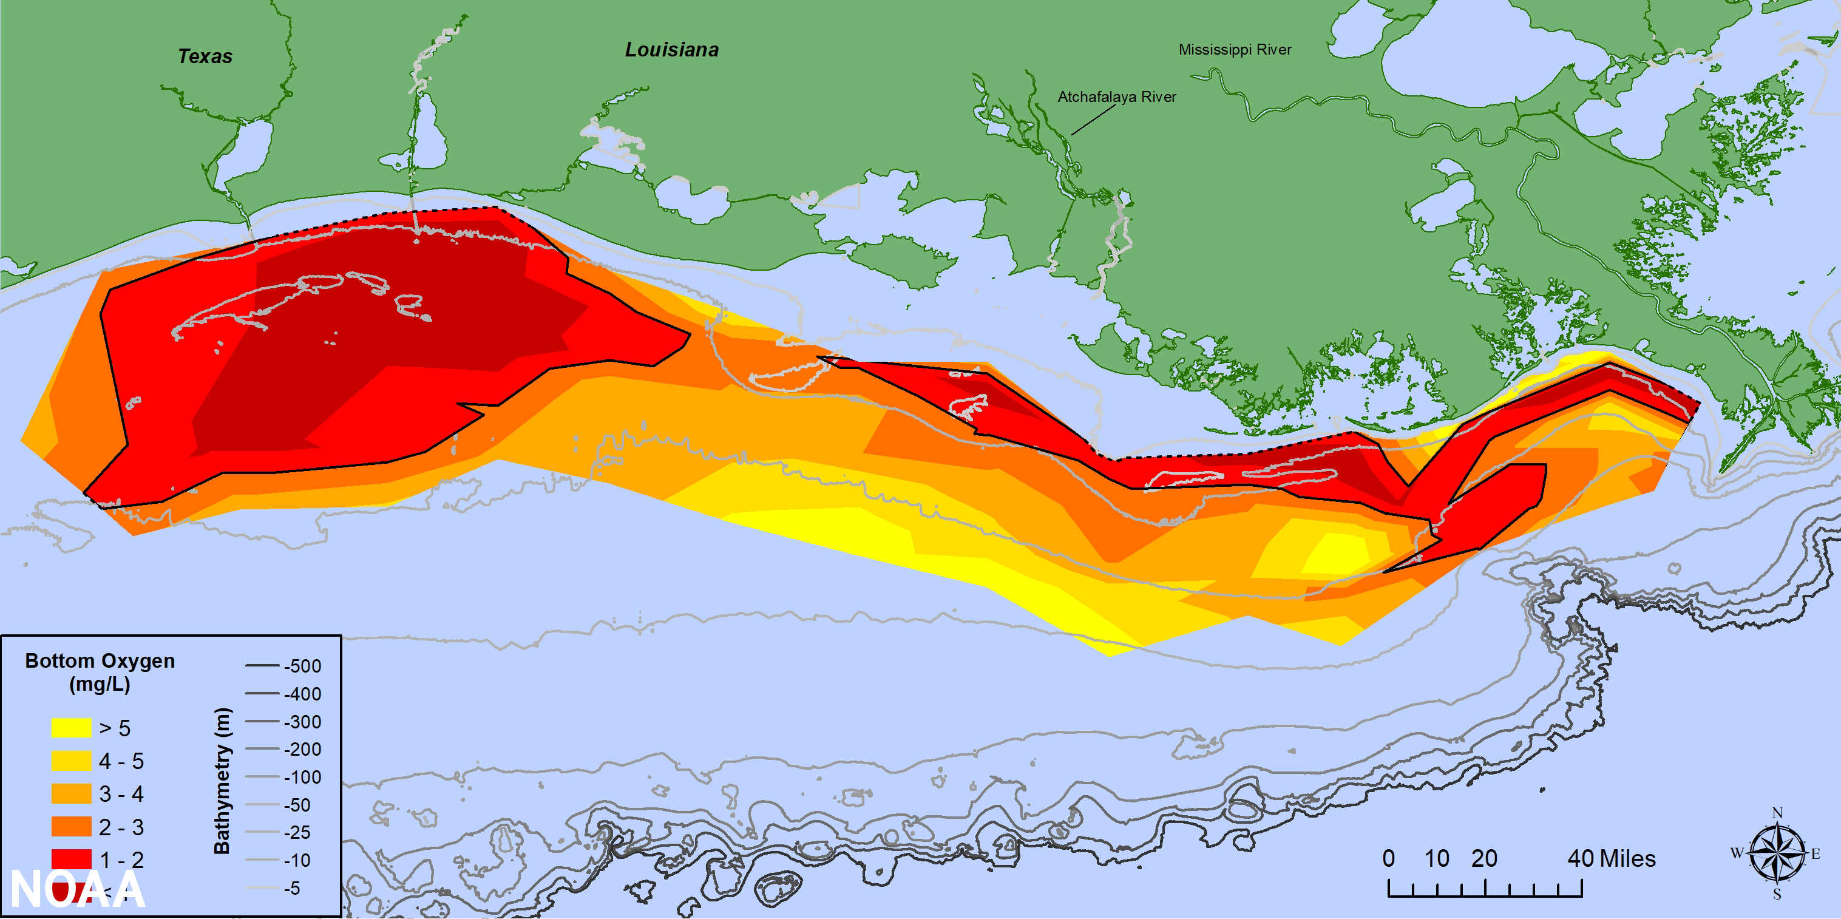
Agricultural Practices and the Environment
Nitrogen input
Gulf of Mexico ‘dead zone’
NOAA. 2021.
Roy et al. 2021. Environmental Research Letters
Massive nitrogen loading in major crop production areas of the United States

Slide 33
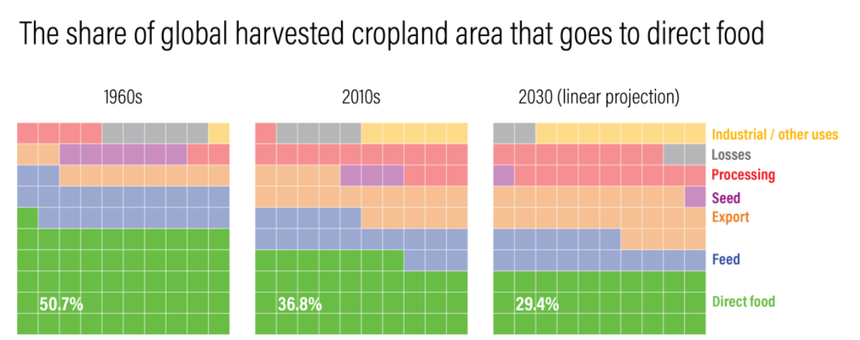
Food Production for Human Consumption
World Resources Institute, 2022

Slide 34
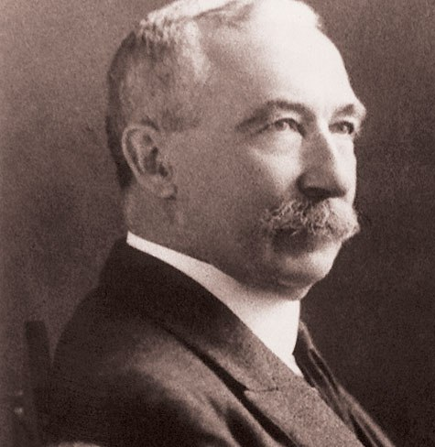
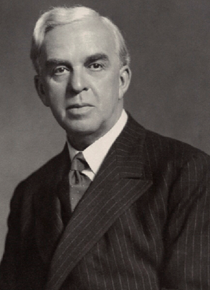
Links between Soil Health and Human Health
“The health of soil, plant, animal, and man is one and indivisible.”
“I know of nothing so potent in maintaining good health… as perfectly constituted food; I know of nothing so potent in producing ill-health as improperly constituted food.”
Sir Albert Howard
An Agricultural Testament
Soil and Health
Sir Robert McCarrison
Studies in Deficiency Disease

Slide 35
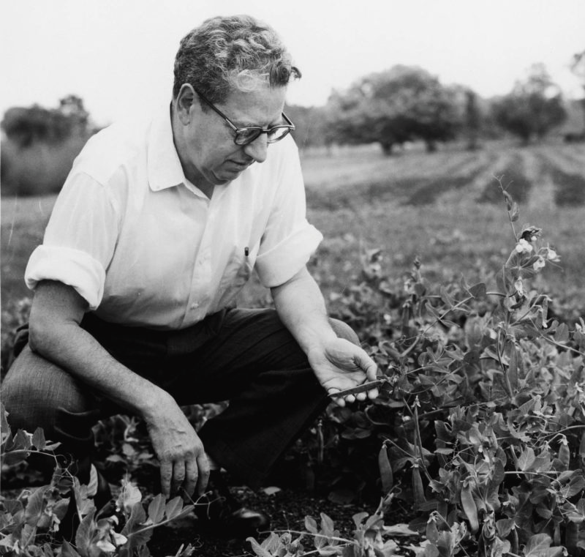
Improving the Health of People and the Planet
Our Story:
Founded in 1947 by Jerome I. Rodale in Kutztown, PA.
Formerly known as the “Soil & Health Foundation”.
Created the ‘Organic Gardening and Farming’ magazine
Popularized the term “organic” in the U.S.
Regional Resource Centers across the U.S.
Research
Education
Organic Consulting
Healthy Soil = Healthy Food = Healthy People

Slide 36
Research in Regenerative Organic Agriculture
Research priorities
Alternative cropping systems
Diversifying corn-soybean rotation with livestock integration.
Organic corn production
Optimizing soil fertility and reducing tillage.
Organic dry bean production
Optimizing the benefits of cover crops and no-till system.
Agroforestry system
Integrating trees, pasture, small grains, and livestock.
Organic vegetable production
Improving soil health using no-till practices.

Slide 37
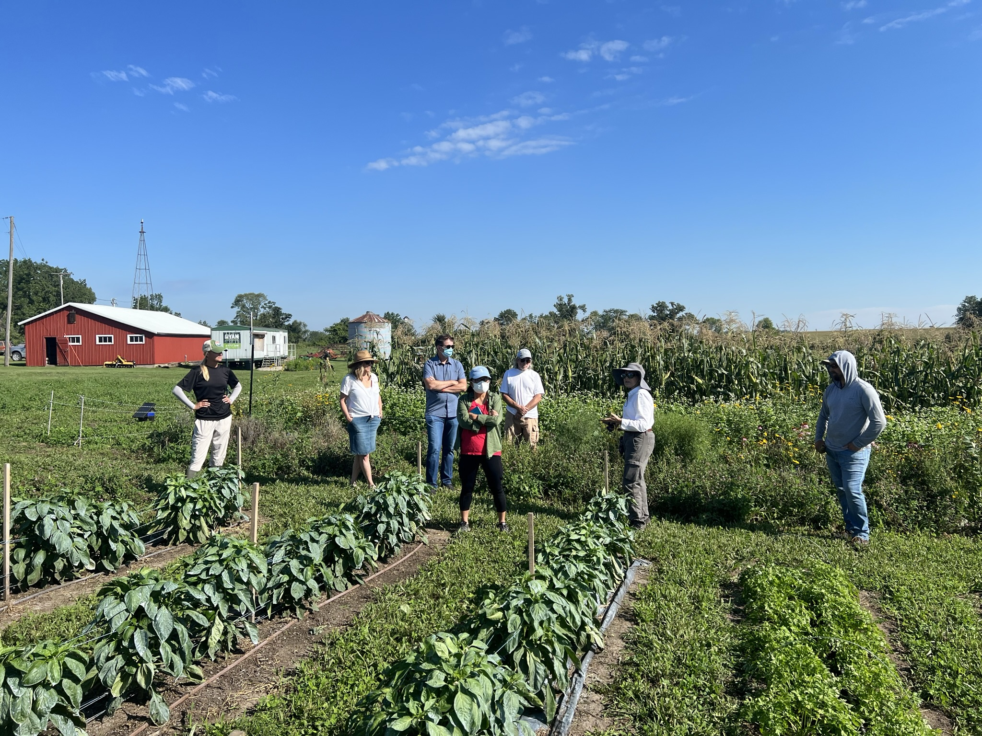
Education through Extension and Outreach
2022 MOC Field Day
Field tours

Slide 38
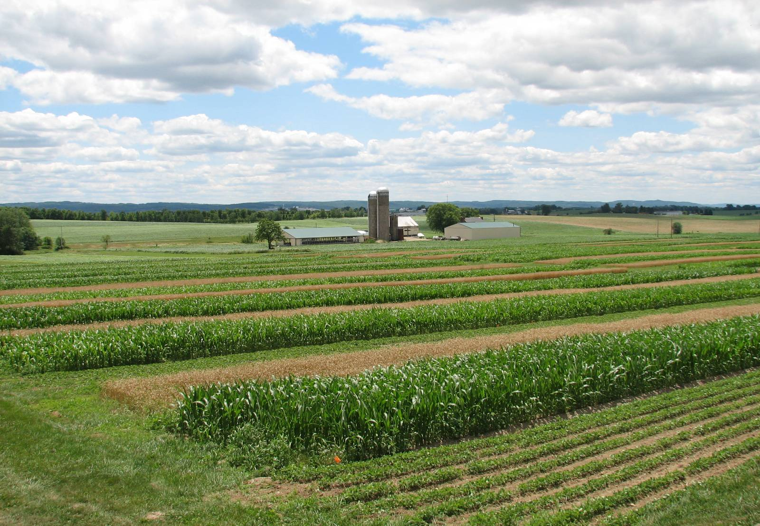
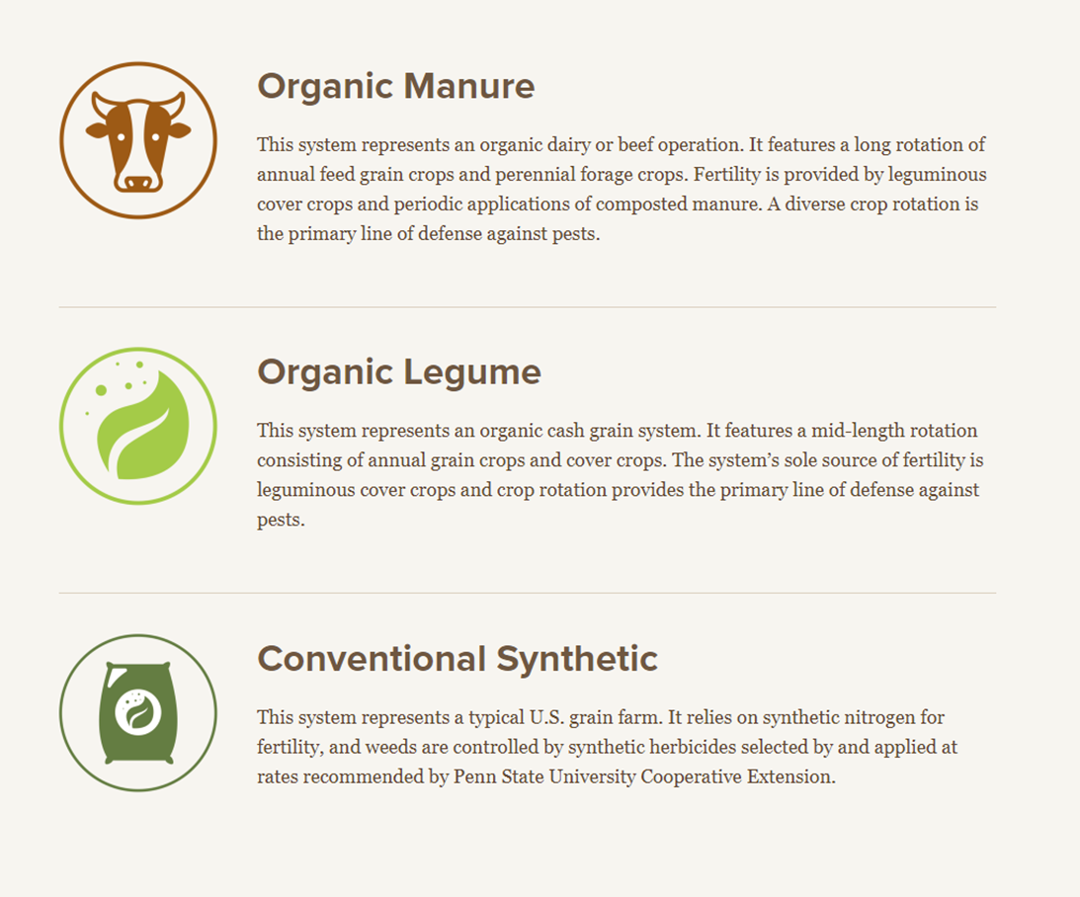
Farming Systems Trial Design

Slide 39
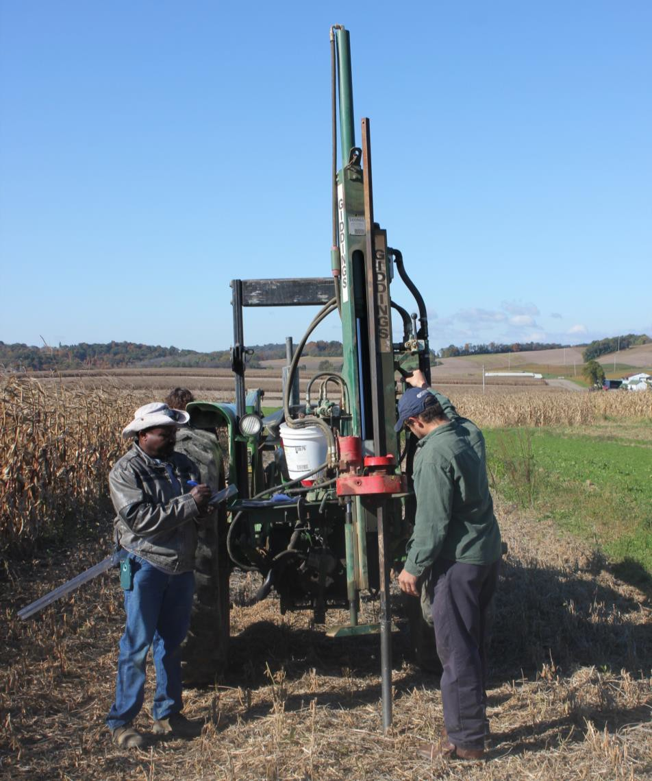
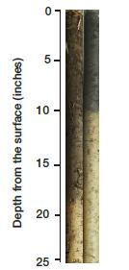
Soil Organic Matter
Conventional
Organic
Organic matter increased quickly when organic practices first instituted

Slide 40
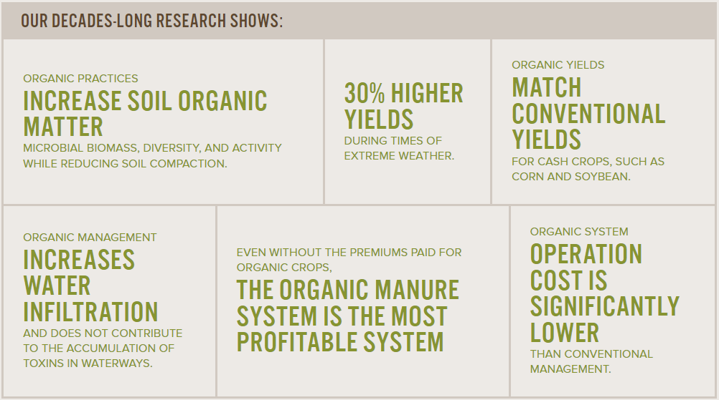
Farming Systems Trial: Conclusions

Slide 41
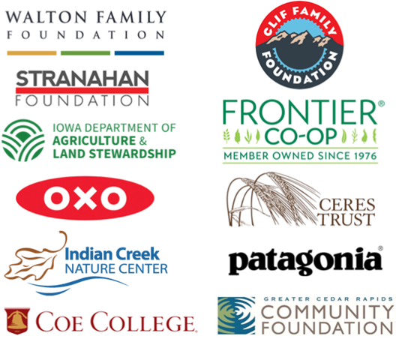
Research | Education | Consulting | Outreach
Rodale Institute Midwest Organic Center thanks its sponsors, supporters, and collaborators:

Slide 42
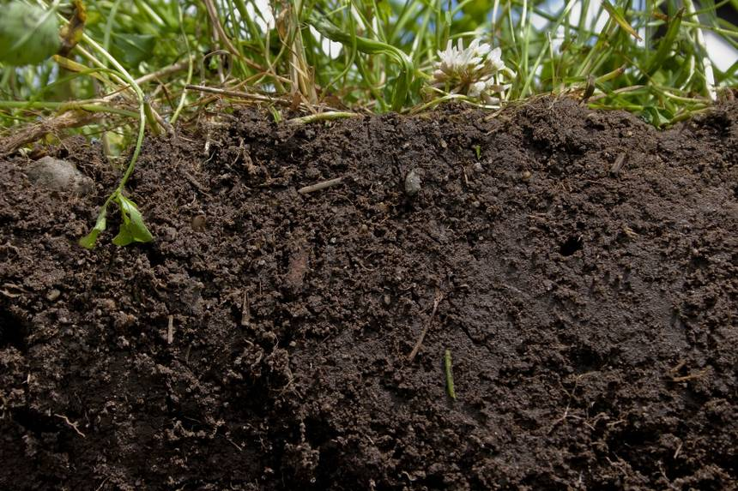


HEALTHY SOIL=HEALTHY FOOD=HEALTHY PEOPLE
“The most important possession of a country is its population. If this is maintained in health and vigor everything else will follow; if this is allowed to decline nothing, not even great riches, can save the country from eventual ruin.”
― Sir Albert Howard

Slide 43
Kamyar Enshayan, Audrey Tran Lam
University of Northern Iowa

Slide 44
Q&A

Slide 45
Lunch Break!
Virtual audience, we will be back at 12:30 p.m. CT!

Slide 46
Welcome back, the HOW Symposium will continue soon!

Slide 47
Congratulations to our Harkin on Wellness Designees!
Argus Farm Stop, Ann Arbor, Michigan
City of San Antonio Metropolitan Health District, San Antonio, Texas
Grady Health Foundation–Food as Medicine Partnership, Atlanta, Georgia
Greener By Default, New York City, New York
Iowa Healthiest State Initiative – Iowa Produce Prescription Program, Des Moines, Iowa
LSI Global Greens Des Moines, Iowa
Planted Society Austin, Texas
Seattle Farm to Preschool, Seattle, Washington
The Frontier Food Hub, Silver City, New Mexico
Waukee Community School District Farm to School Program, Waukee Iowa

Slide 48
USDA’s Actions to Advance Food and Nutrition Security
Stacy Dean
USDA Deputy Under Secretary for Food, Nutrition, and Consumer Services

Slide 49

Trends in the prevalence of food insecurity and very low food security in U.S. households, 2001-21, percent of households
Food insecurity
Very low food security
Coleman-Jensen A, Rabbitt MP, Gregory CA, and Singh A. Household Food Security in the United States in 2021. Economic Research Report No. (ERR-309), published September 2022

Slide 50


Racial inequality is evident in many domains

Slide 51

Structural racism in practice

Slide 52



Improving dietary intake is critical
Slide content
Slide content
Slide content
NOTE: HEI-2015 total scores are out of 100 possible points. A score of 100 indicates that recommendations on average were met or exceeded. A higher total score indicates a higher quality diet.
Data Source: Analysis of What We Eat in America, NHANES 2015-2016, ages 2 and older, day 1 dietary intake data, weighted.

Slide 53




Nutrition security:
Ensuring all Americans have consistent and equitable access to healthy, safe, and affordable foods essential for optimal health and well-being

Slide 54




1 in 4 Americans is served by one of USDA’s 15 nutrition assistance programs

Slide 55

Uniquely positioned to impact food and nutrition security
Nutrition assistance programs
Dietary Guidelines and MyPlate
Nutrition education and promotion
Other USDA equities

Slide 56




Providing Nutrition Support from Pregnancy to Birth and Beyond
Connecting All Americans with Healthy, Safe, Affordable Food
Developing, Translating, and Enacting Nutrition Science Through Partnership
Prioritizing Equity Every Step of the Way
https://www.usda.gov/nutrition-security

Slide 57

Title
Slide content
Slide content
Slide content

Slide 58

SNAP benefits increased by 21%

Slide 59

Title
Slide content
Slide content
Slide content

Slide 60



Slide 61


Slide 62

Critical recent changes to SNAP-Ed
Creating a new Nutrition Education Branch in SNAP to support SNAP-Ed
Improving data collection
Establishing a National license for the Program Evaluation and Reporting Systems or N-PEARS for short
Encouraging maximum flexibility in the use of policy, systems, and environmental change approaches

Slide 63


Slide 64

Title
Slide content
Slide content
Slide content

Slide 65



White House Conference on Hunger, Nutrition, and Health

Slide 66


National Strategy
-Five Pillars
Improve food access and affordability
Integrate nutrition and health
Empower all consumers to make and
have access to healthy choices
Support physical activity for all
Enhance nutrition and food research

Slide 67



National Strategy Pillar 1:
Improve Food Access & Affordability

Slide 68

National Strategy Pillar 2:
Integrate Nutrition & Health

Slide 69



National & Regional Healthcare Summits
Encourage action and engagement
Strengthen and build connections
Raise awareness of USDA equities
Increase exposure to successful models

Slide 70



Title
Slide content
Slide content
Slide content
National Strategy
Pillar 3:
Empower All Consumers to Make & Have Access to Healthy Choices

Slide 71

Improving the WIC food packages
https://www.fns.usda.gov/wic/fr-112122

Slide 72

National Strategy Pillar 4:
Support Physical Activity for All

Slide 73




National Strategy Pillar 5:
Enhance Nutrition & Food Security Research
National Institute of Food and Agriculture (NIFA)
Food and Nutrition Service
Office of Policy Support

Slide 74


Slide 75
Recent FNS Food & Nutrition Security Investments
Increasing SNAP Benefits to Support Healthy Eating
Bringing SNAP and WIC Shopping Online
Strengthening Evidence to Inform FNS Policy and Nutrition Services
Supporting a Diverse WIC Workforce
Restructuring SNAP-Ed
Modernizing WIC to Improve Reach

Slide 76

Key Takeaways
Food insecurity and diet-related diseases are rising
Mobilize key USDA assets
Collaborate with partners—
like you

Slide 77

USDA programs could be helping more eligible families

Slide 78


THANK YOU & STAY CONNECTED
www.usda.gov/nutrition-security
@USDANutrition

Slide 79
Q&A

Slide 80
HOW Designee Breakout Sessions
Unfortunately, these breakout sessions are only available live for in person attendees.
Video recordings of the breakout sessions posted on The Harkin Institute YouTube channel after the event. Registered virtual attendees will receive an email when they are available
Symposium livestream will resume at 2:30 p.m. CT

Slide 81
Welcome back , the HOW Symposium will continue soon!

Slide 82
Moderator: Luke Elzinga, DMARC
Erin McDonald, Health and Human Services
Anne Palmer, Johns Hopkins University Center for a Livable Future
Kendal Chavez, New Mexico Governor’s Office
Panel Two: Healthy Food in Communities

Slide 83
Anne Palmer
Johns Hopkins University Center for a Livable Future

Slide 84

NWI Food Policy Council (IN)
Problem: Barriers to quality of life, farm aspirations food access for migrant workers; conducted listening sessions with migrant farmworkers
Partners: Family Farmed, Proteus, Pax Center
Program: 600 farms-to-families food boxes were distributed; Additional programming to support migrant farmworkers quality of life Family Farmed

Slide 85

Adams County Food Policy Council (PA)
Problem: people ineligible for federal food assistance still need assistance to access FM
Partners: individual donations, Gettysburg Hospital Foundation, private orgs
Program/policy: $40/monthly vouchers; reached 152 families, purchased $67,000 FV
Example from policy dashboard for ACFPC

Slide 86

Linn Co Food Systems Council (IA)
Problem: Smaller orgs without grant writing skills, ESL, have difficulty getting support
Partner: grant from Board of Supervisors thru ARPA
Program/policy: awarded $132,300 in microgrants to 12 local organizations through its grant program.
Will support infrastructure, vehicles and equipment including fencing, tractors and cold storage.
Photo credit: The Gazette, 3/13/23.

Slide 87
Worcester Food Policy Council (MA)
Problem: 20-25% of food pantry clients were already working
Partner: Raise Up Massachusetts
Policy: legislation passed in 2018 increased the minimum wage, $15/hr by 2023; started a paid family and medical leave program
Council participated in lobbying, public action, collecting signatures for the ballot initiatives, and hosting community forums on the issue

Slide 88

Rhode Island Food Policy Council
Problem: SNAP recipient during pandemic, needed to order groceries online, use EBT cards, delivery
Partners: Dept of Human Services, grocers, HETF, Cartwheel, partners for referrals
Policy/program: Piloted no-cost SNAP delivery 20 HH Policy recommendations: Establish a dedicated help line for SNAP recipients to order food for delivery; TA program for vendors, Local policy – increase SNAP/WIC vendors

Slide 89
Kendal Chavez
New Mexico Governor’s Office

Slide 90




Slide 91




Slide 92



Slide 93




Slide 94
Q&A

Slide 95
The Iowa Good Food Plan Discussion

Slide 96
Thank you for coming!

