Slide 1
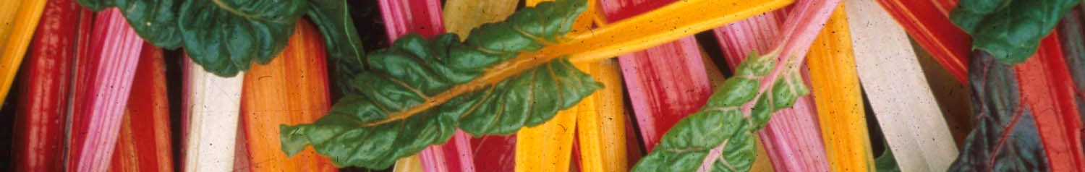
Is there a path for healthy and sustainable diets for all?
Walter C. Willett, MD, DrPH
Department of Nutrition
Harvard T. H. Chan School of Public Health
April 13, 2023

Slide 2
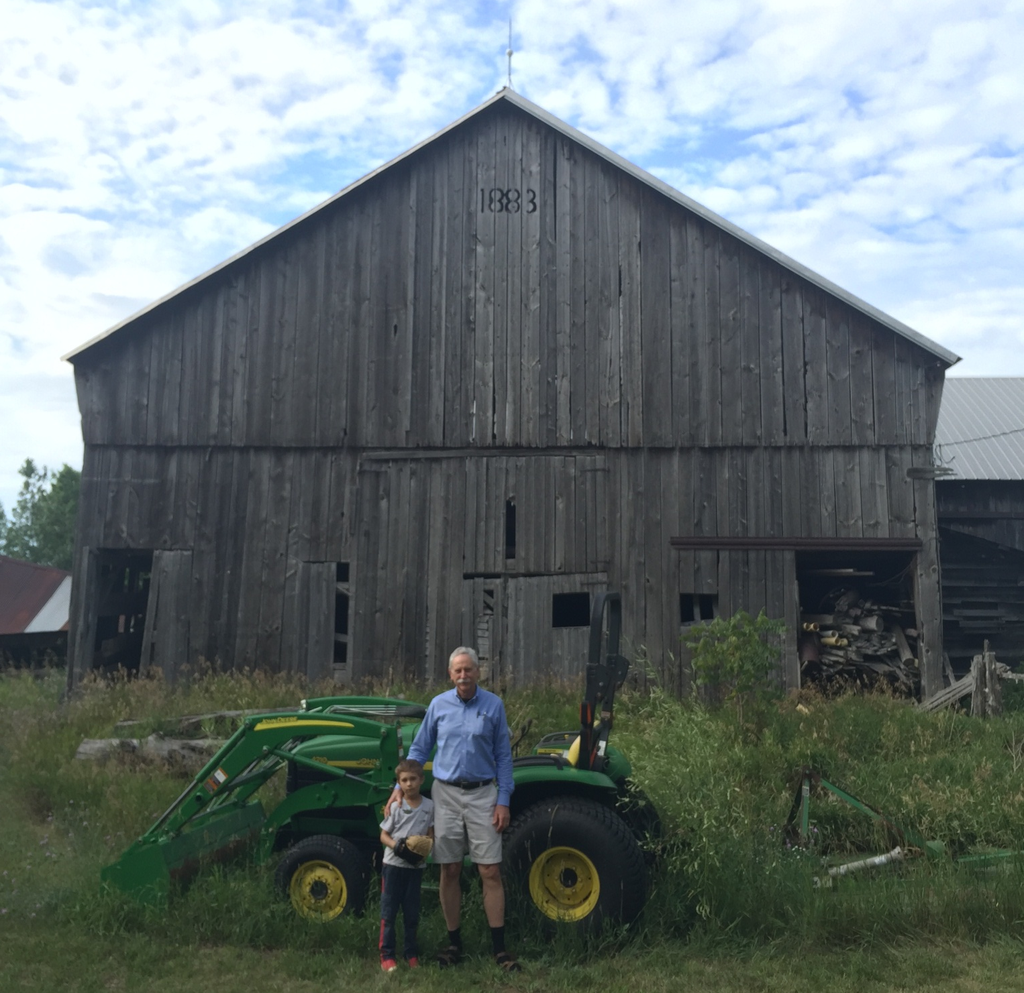
20.441

Slide 3
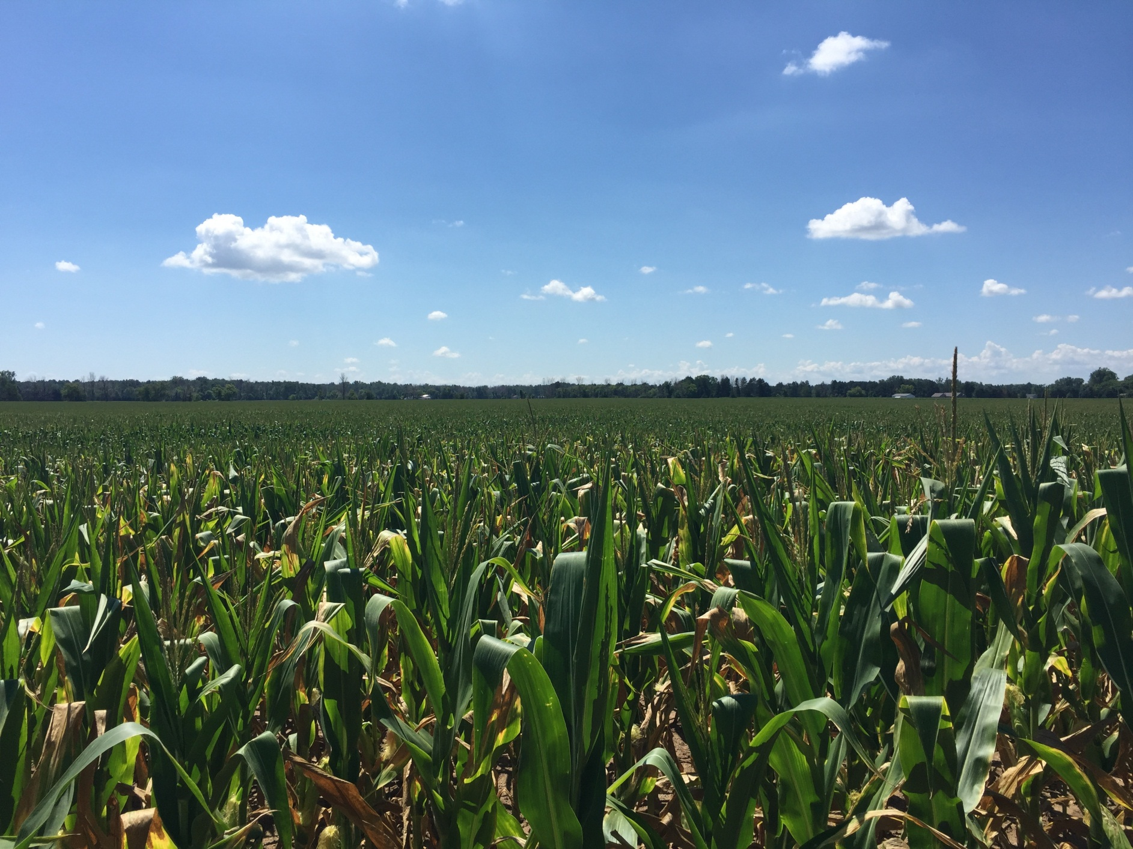
14.007

Slide 4
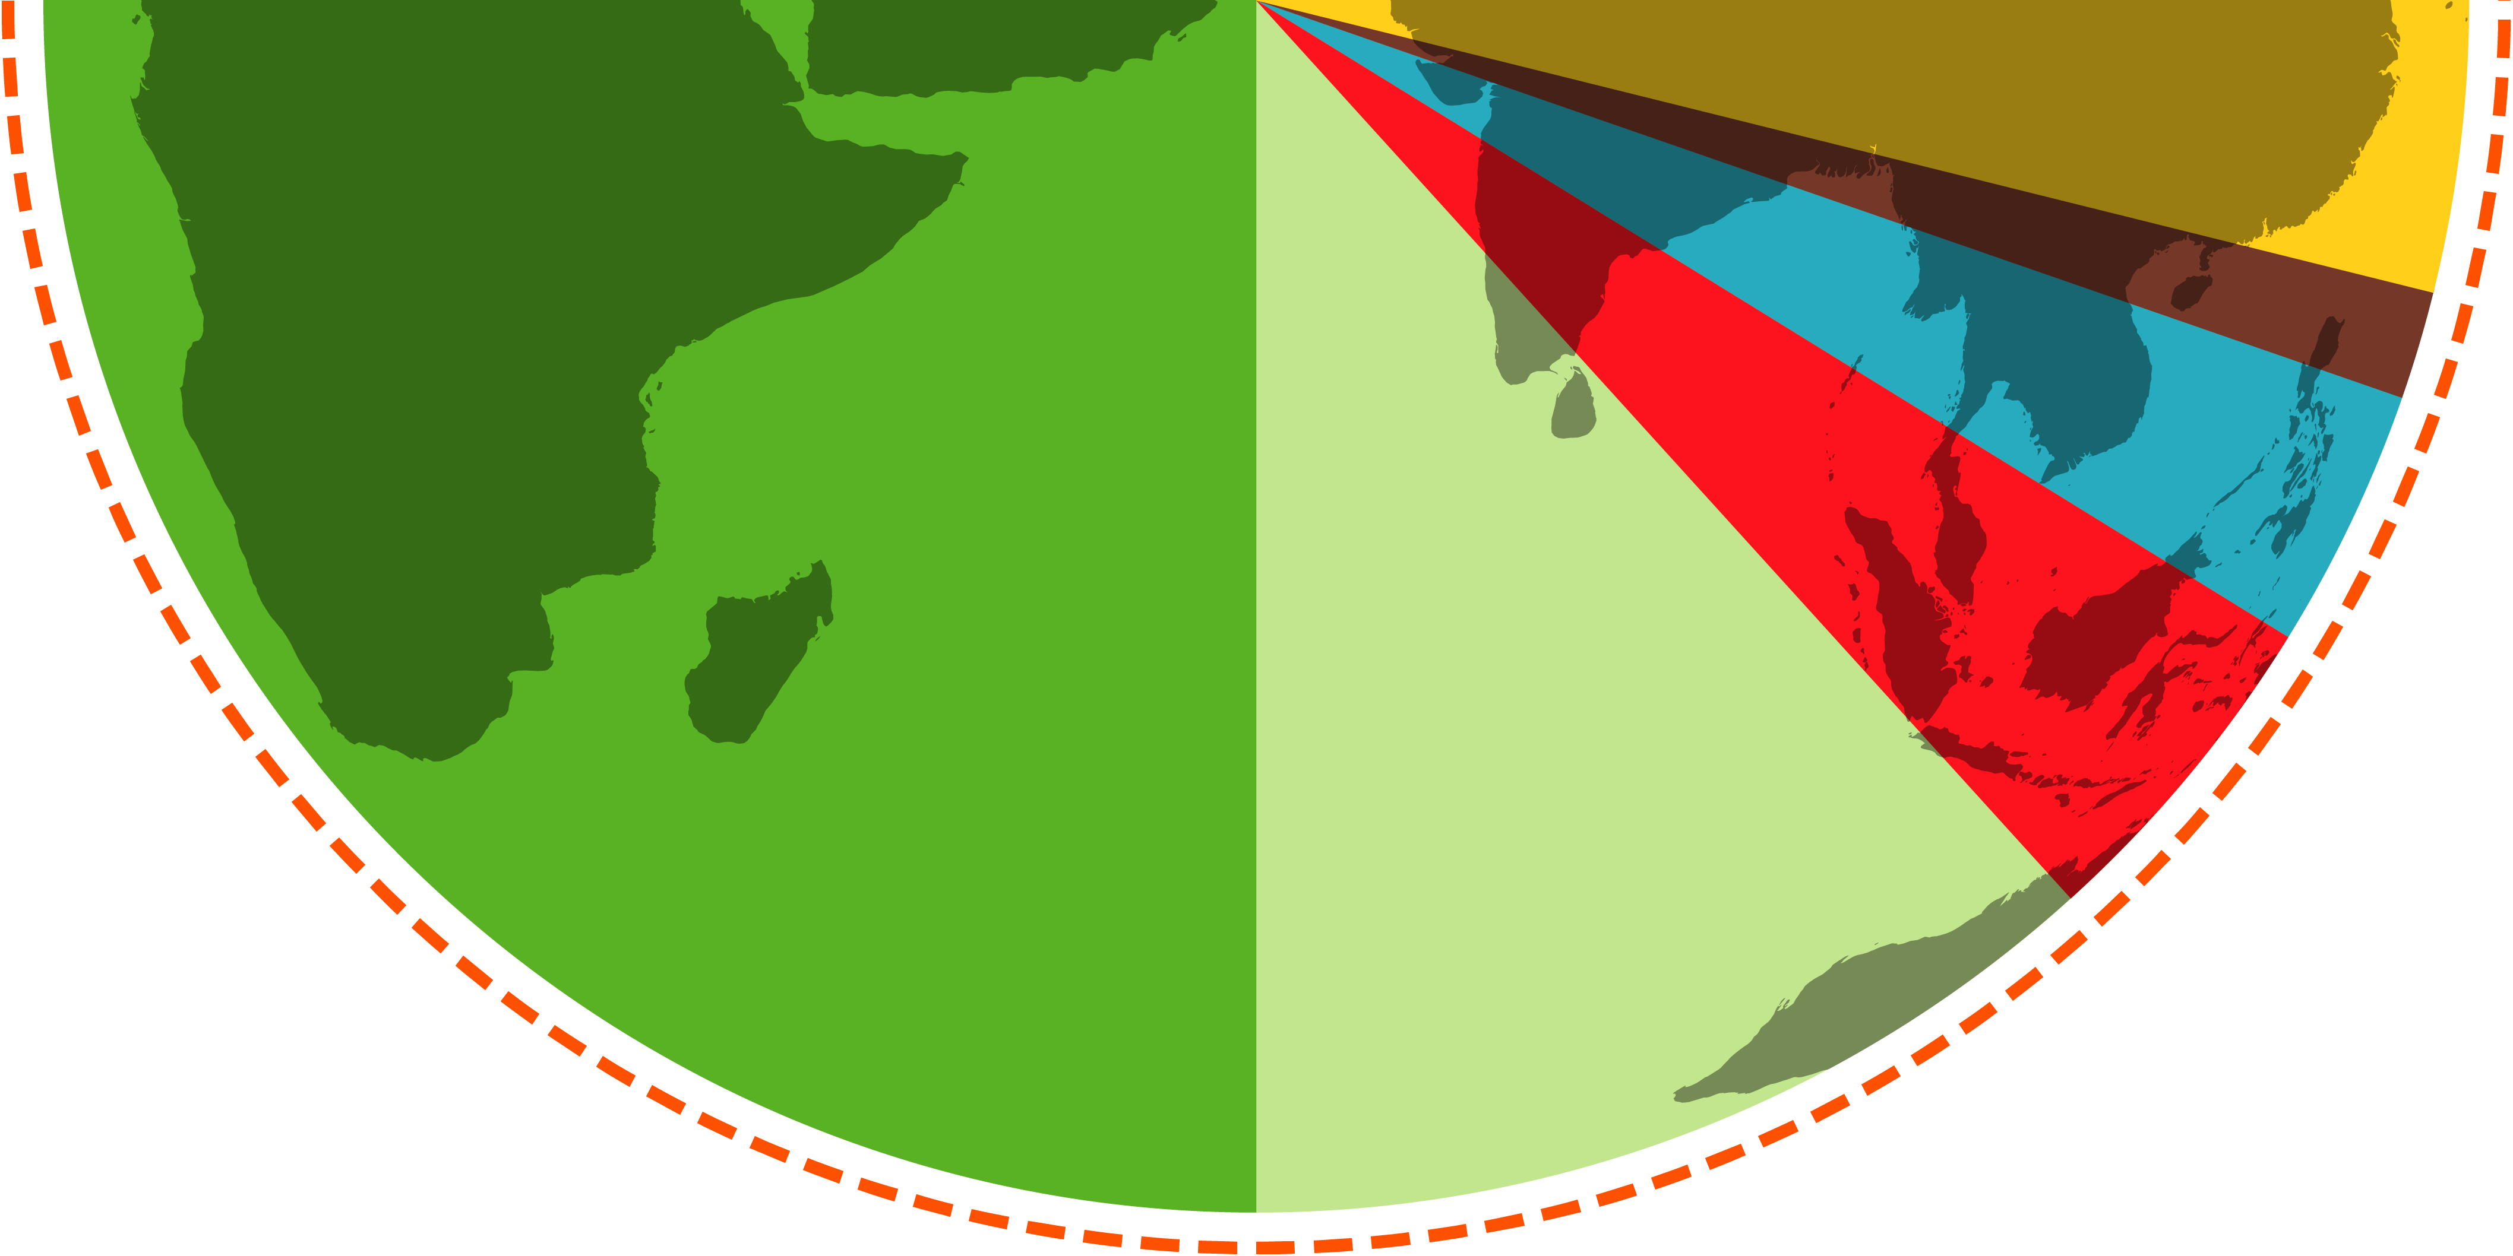

Food
Planet
Health
The EAT-Lancet Commission on
Healthy Diets From
Sustainable Food Systems
14.023
https://www.thelancet.com/journals/lancet/article/PIIS0140-6736(18)31788-4/fulltext

Slide 5
EAT/Lancet Commission
The Challenge: How to feed 9.8 billion people in 2050 a diet that is healthy and sustainable
Standard Response: Increase food production, mostly grains, by 70%, much of it to feed animals that people will want to consume (Business as Usual)
https://www.thelancet.com/commissions/EAT
42.012

Slide 6
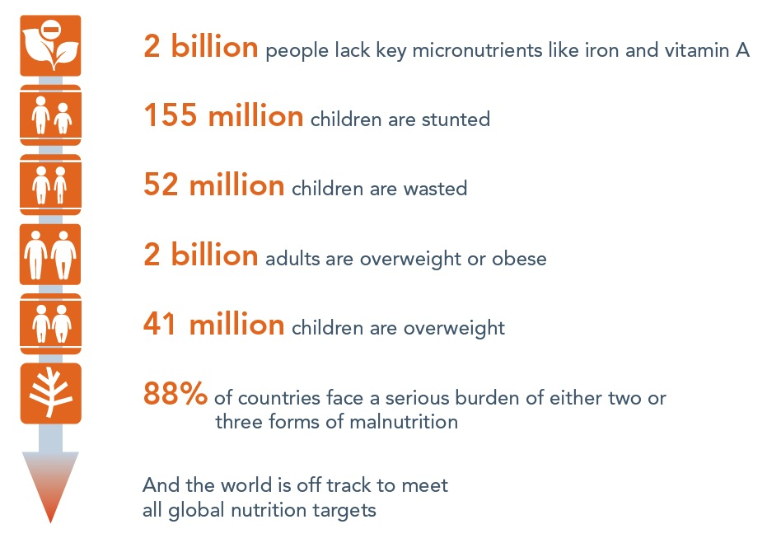

The scale of the challenge
Diet quality is far from optimal in all countries
14.027-FNCE

Slide 7
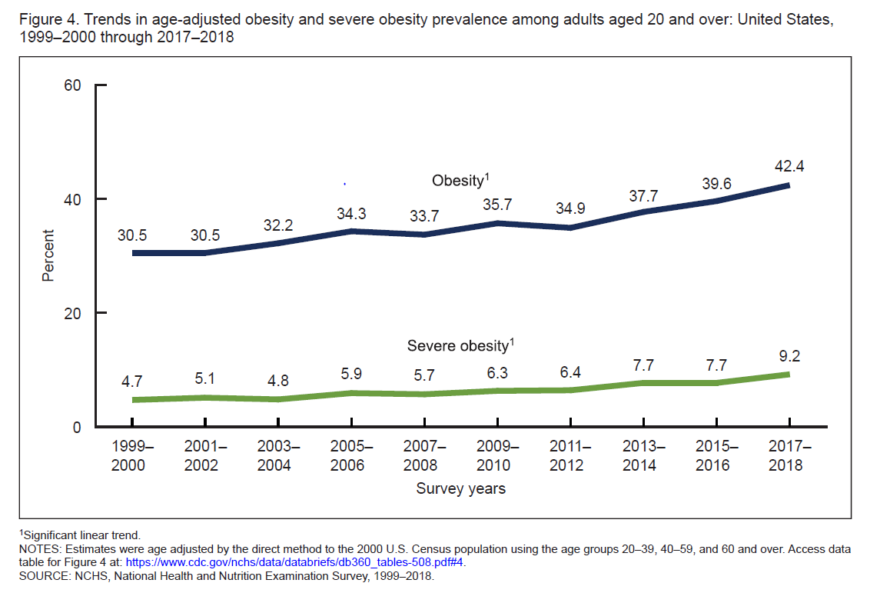
1970
29.751b

Slide 8
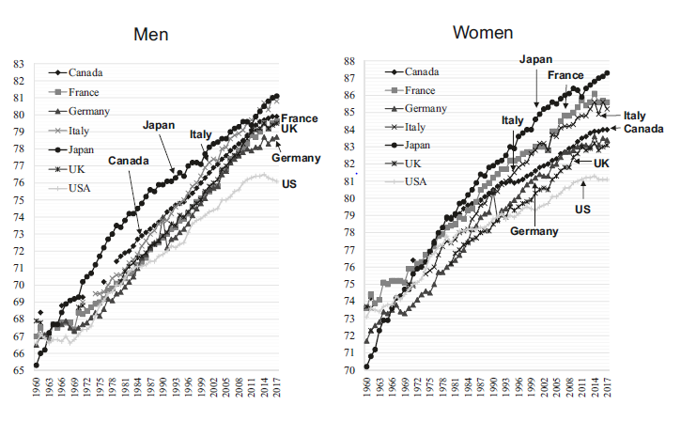
Annual trends of life expectancy at birth (years) in selected countries
: (Tsugane S, Eur J Clin Nutr 2020)
29.792
https://www.oecd.org/health/health-data.htm

Slide 9
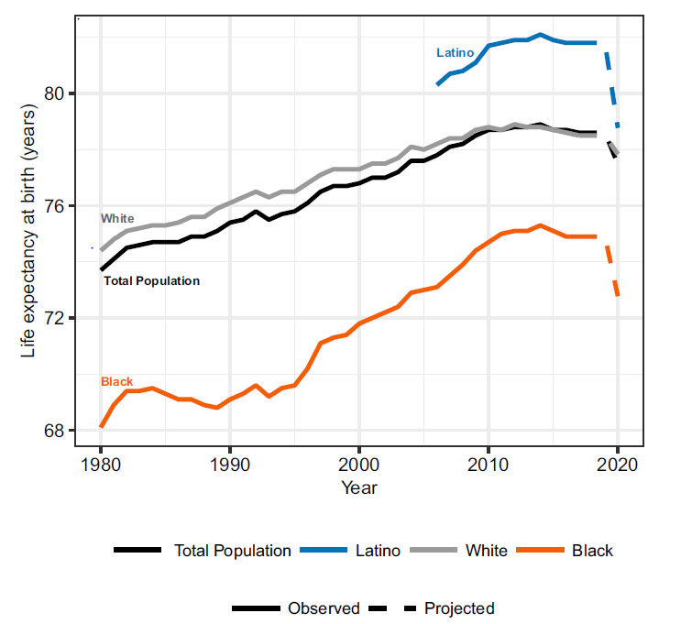
Effect of COVID on life expectancy
46.005
(Adrasfay T, PNAS, 2021)

Slide 10
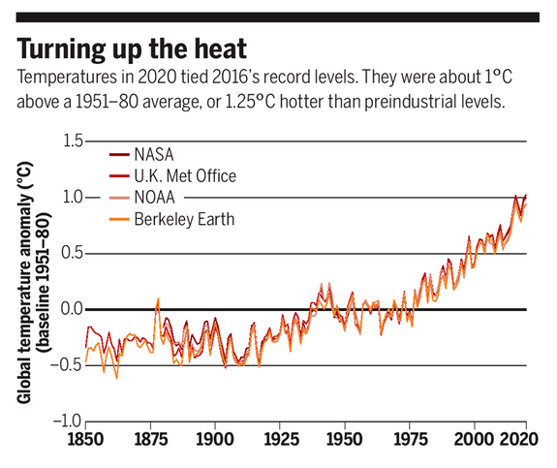
Science, 22 Jan, 2021 vol 371, page 335
40.031

Slide 11
EAT-Lancet Commission Approach
Define a healthy reference diet using the best available evidence (controlled feeding studies, long-term cohort studies, randomized trials).
Define planetary boundaries for 6 key environmental systems and processes (GHG, cropland use, water use, nitrogen and phosphorus application, extinction rate).
Apply a global food systems modeling framework to analyze what combinations of measures are needed to stay within planetary boundaries while still delivering healthy diets by 2050.
Outline Strategies
14.030-FNCE

Slide 12
Ratio of Polyunsaturated Fat to Saturated Fat (P/S Ratio) for Major Protein Sources
P/S Ratio
Type of Food
14.076

Slide 13
Meta-analysis assessing the effects of red meat on LDL cholesterol (mmol/L) from RCTs by type of comparison diet
(Guasch-Ferre M et al. Circulation 2019)
P=0.003
High-quality plant protein (e.g. legumes, soy, nuts)
Animal protein
(fish, poultry, red meat, dairy)
Usual diet
14.067

Slide 14
Network meta-analysis of 66 randomized trials of food group effects on risk factors for cardiometabolic disease
(LDL-C, TG, TC, HDL-C, FG, HbA1c, HOMA-IR, SBP, DBP, CRP)
Summary Ranking Score
14.080
(Schwingschakl L, Am J Clin Nutr 2017)

Slide 15
Nurses’ Health Study (n=121,700)
1976
‘80
‘82
‘84
‘86
‘88
‘90
‘94
‘96
‘98
2000
‘02
‘04
‘06
‘08
‘10
‘12
‘14
‘78
‘92
‘16
OCS
Smoking
Weight/Ht
Med Hx
Diet
Nails
Blood/Urine
Diet
Diet
Diet
Diet
Blood
Diet
Health Professionals Follow-up Study (n=52,000)
Diet
Diet
1986
‘88
‘90
‘92
‘94
‘96
‘98
2000
‘02
‘04
‘12
‘14
‘16
‘06
‘08
‘10
Nails
Diet
Diet
Diet
Diet
Diet
Diet
Diet
Blood
Nurses’ Health Study II (n=116,000)
Diet
1989
‘91
‘93
‘95
‘05
‘07
‘09
‘11
‘13
‘97
‘99
‘15
2001
‘03
Diet
Blood/ Urine
Diet
Diet
Diet
Blood
Diet
Diet
Investigators: Frank Speizer, Bernie Rosner, Meir Stampfer, David Hunter, JoAnn Manson, Eric Rimm, Edward Giovannucci, Alberto Ascherio, Gary Curhan, Michelle Holmes, Frank Hu, Heather Eliassen, Lorelei Mucci, Jae Hee Kang, Jorge Chavarro, Molin Wang, Kana Wu, Andrew Chan, Daniel Wang, Qi Sun
Diet
0.386R

Slide 16
Differences in all-cause mortality for major protein sources vs dairy (for 3% of energy from protein)
(recalculated from Song M et al. JAMA Intern Med 2016)
56
Percent Difference in All-Cause Mortality
Dairy
Plant
sources
Poultry
Unprocessed meat
Processed meat
Fish
Eggs
29.724

Slide 17
Relation of red meat to risk of Type 2 diabetes in NHS, NHSII, and HPFS (204,156 men and women, 13,759 incident cases)
Relative Risk (95% CI)
Target
RR for 1 svg/day = 1.14 (1.10, 1.18), P-trend <0.001
Quintiles of red meat intake, servings/day
*Servings are average for 3 cohorts, considering 85 g/svg (3%)
**N.B. Intake of red meat in “optimal diet” = 19 g/day (Micha R et al. PLoS One 2017)
14.058
(Pan A et al. AJCN 2011)

Slide 18
Scientific Targets for Healthy Diets
(2500 Kcal/day)
Food group | Food subgroup | Reference diet (g/day) | Possible ranges (g/day)
Whole Grains | All grains | 232 | 0 to 60% of energy
Tubers/Starchy Vegetables | Potatoes, cassava | 50 | 0 to 100
Vegetables | All vegetables | 300 | 200 to 600
Fruits | All Fruits | 200 | 100 to 300
Dairy Foods | Dairy Foods | 250 | 0 to 500
Protein Sources | Beef, lamb, pork | 14 | 0 to 28
 | Chicken, other poultry | 29 | 0 to 58
 | Eggs | 13 | 0 to 25
 | Fish | 28 | 0 to 100
 | Dry beans, lentils, peas | 50 | 0 to 100
 | Soy | 25 | 0 to 50
 | Nuts | 50 | 0 to 75
Added fats | Unsaturated oils | 40 | 20-80
 | Saturated oils | 12 | 0 to 7
Added sugars | All sweeteners | 31 | 0 to 31
1 glass of milk or equivalent
14.015c

Slide 19
Scientific Targets for Healthy Diets
(2500 Kcal/day)
Food group | Food subgroup | Reference diet (g/day) | Possible ranges (g/day)
Whole Grains | All grains | 232 | 0 to 60% of energy
Tubers/Starchy Vegetables | Potatoes, cassava | 50 | 0 to 100
Vegetables | All vegetables | 300 | 200 to 600
Fruits | All Fruits | 200 | 100 to 300
Dairy Foods | Dairy Foods | 250 | 0 to 500
Protein Sources | Beef, lamb, pork | 14 | 0 to 28
 | Chicken, other poultry | 29 | 0 to 58
 | Eggs | 13 | 0 to 25
 | Fish | 28 | 0 to 100
 | Dry beans, lentils, peas | 50 | 0 to 100
 | Soy | 25 | 0 to 50
 | Nuts | 50 | 0 to 75
Added fats | Unsaturated oils | 40 | 20-80
 | Saturated oils | 12 | 0 to 7
Added sugars | All sweeteners | 31 | 0 to 31
1 hamburger
per week
14.015d

Slide 20
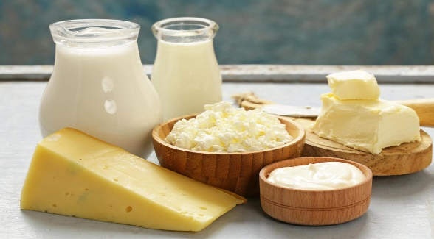
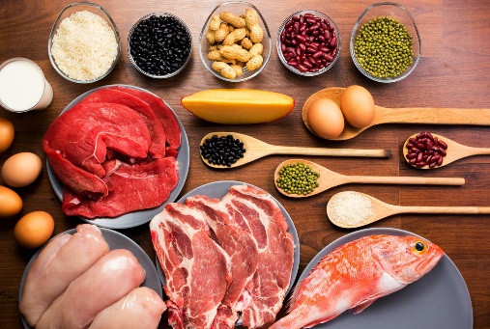
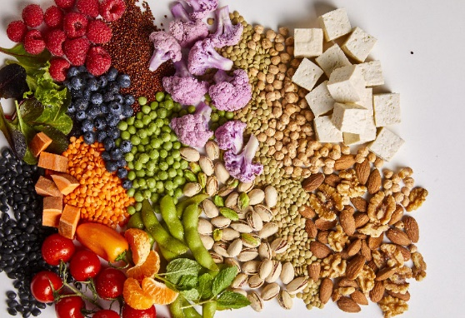
Planetary Health Diet Bottom Line
(Flexitarian)
Servings/Day of Animal Source Foods (Optional)
+ 1
Dairy
Other
(fish, poultry, eggs, red meat)
Base: Nuts, soy, beans, fruit, vegetables, whole grains, plant oils
28.049

Slide 21
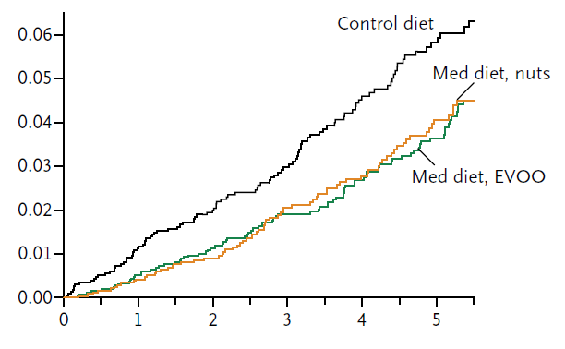
Kaplan-Meier Estimates of the Incidence of Outcome Events in the Total Predimed Study Population
Years
(Estruch R et al. NEJM 2013)
9.246

Slide 22
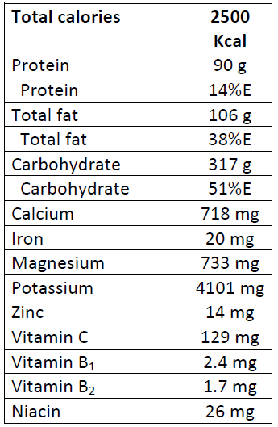
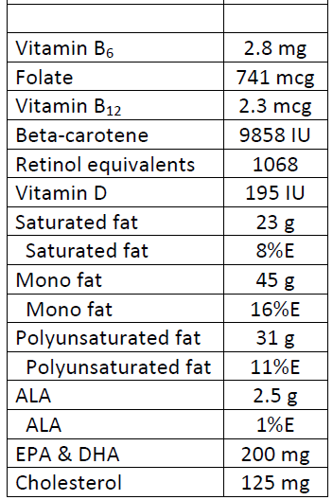
Nutrient Composition of Healthy Reference Diet (Daily Values)
*
*Supplement needed if animal foods are lower
14.060R

Slide 23
Reality Check: Protein Sources in Traditional Mediterranean Diet
Total of red meat plus poultry:
Greek men living in Crete in 1960s:
35 grams per day
(Willett WC et al. Am J Clin Nutr 1995)
EAT-Lancet reference diet:
43 grams per day
14.057

Slide 24
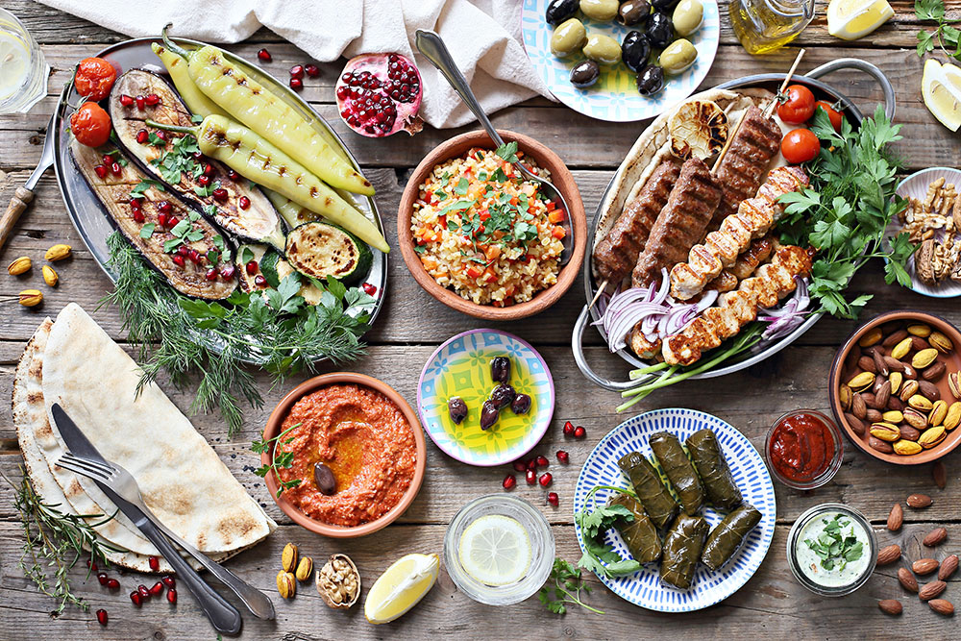
14.091

Slide 25
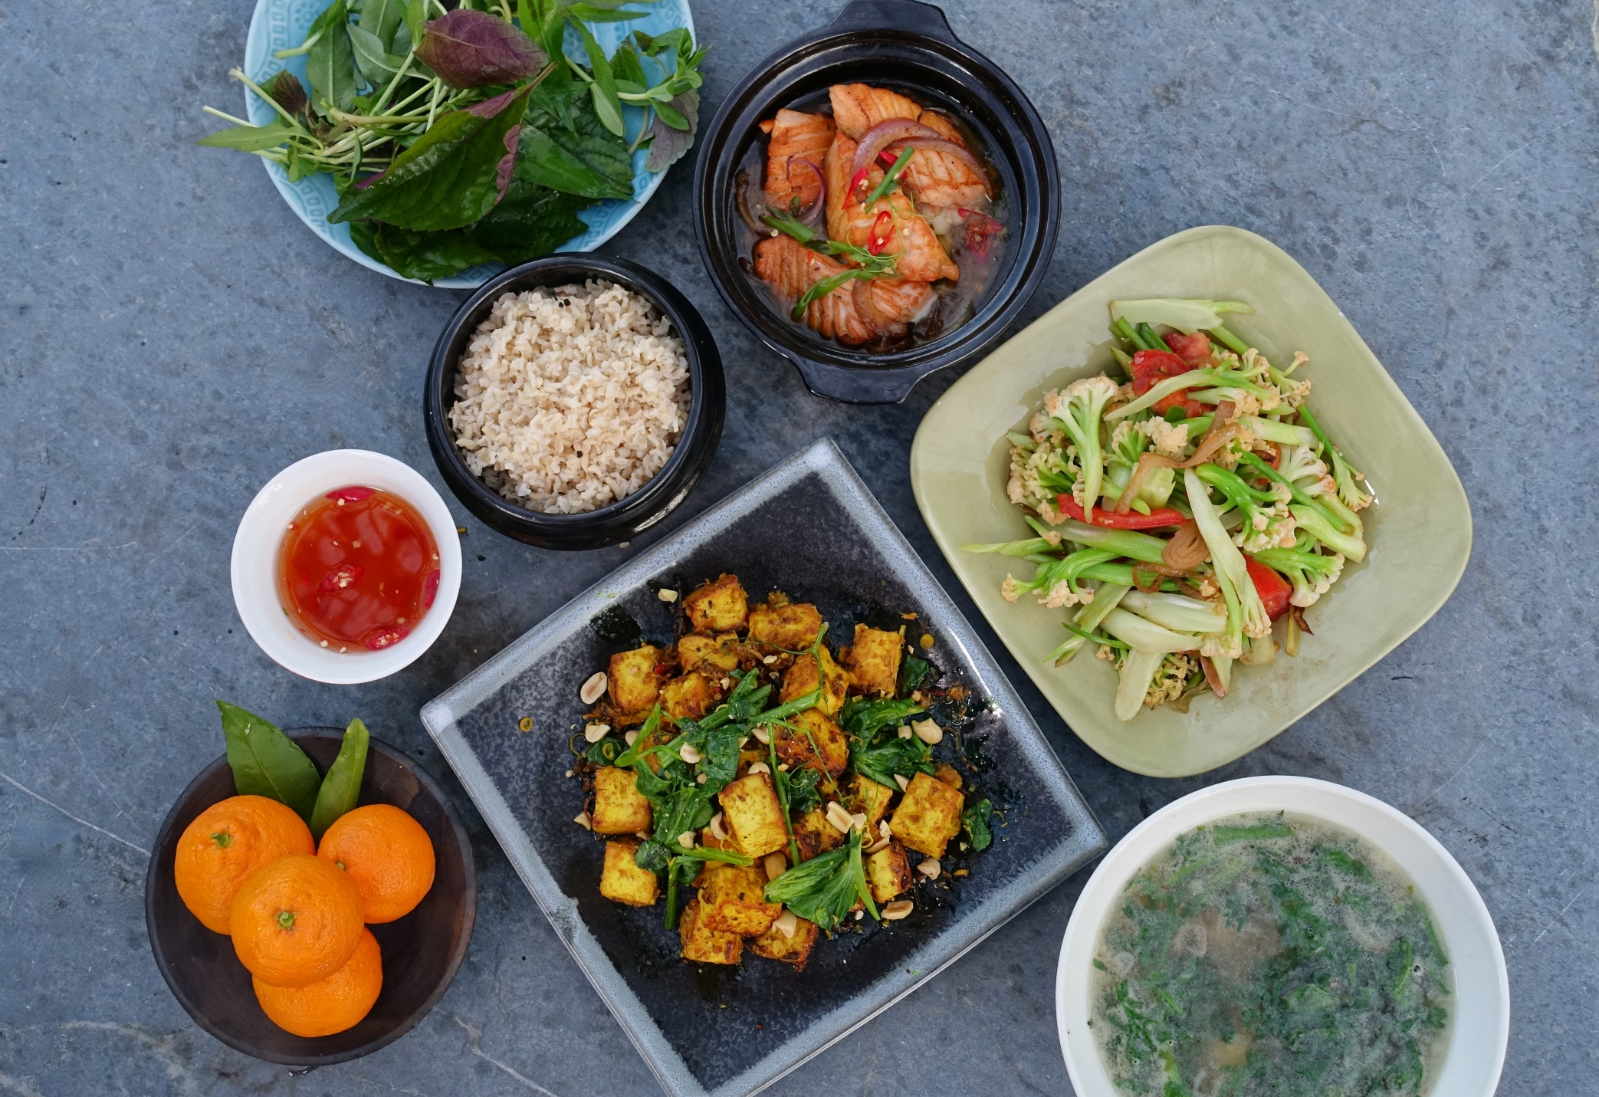
Mai Pham, STAR GINGER| LEMON GRASS KITCHEN
14.099

Slide 26
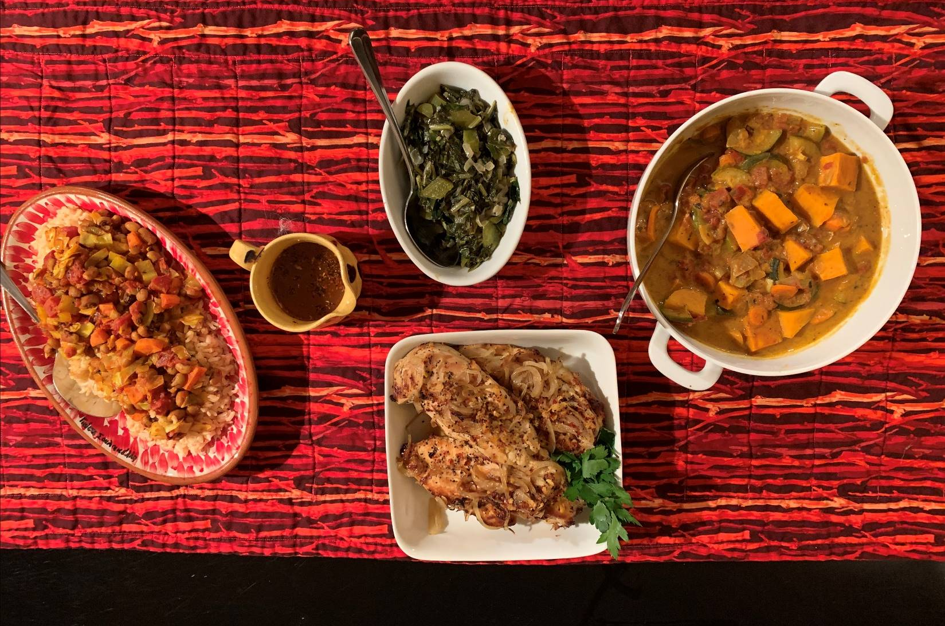
: Sara Baer-Sinnott, Oldways
14.102

Slide 27
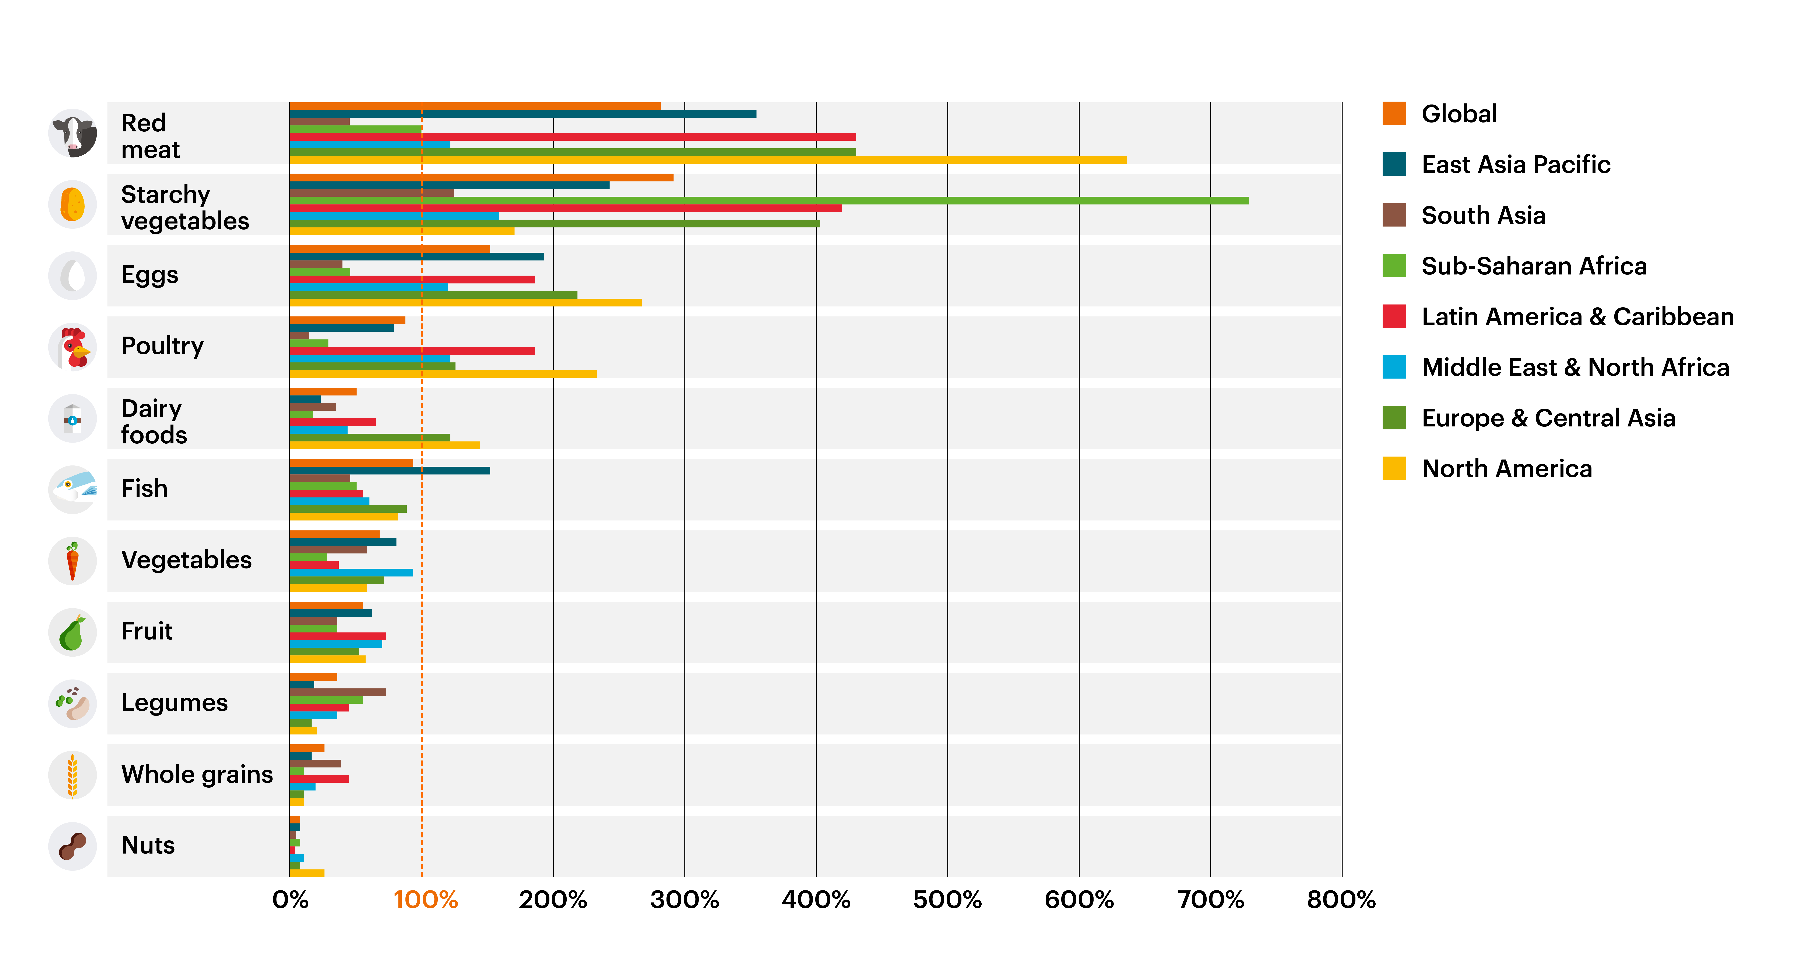
Current Intakes vs Planetary Health Diet
14.037

Slide 28
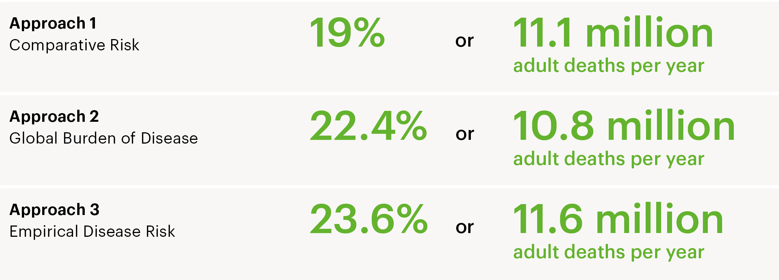
Substantial Health Benefits
14.038

Slide 29
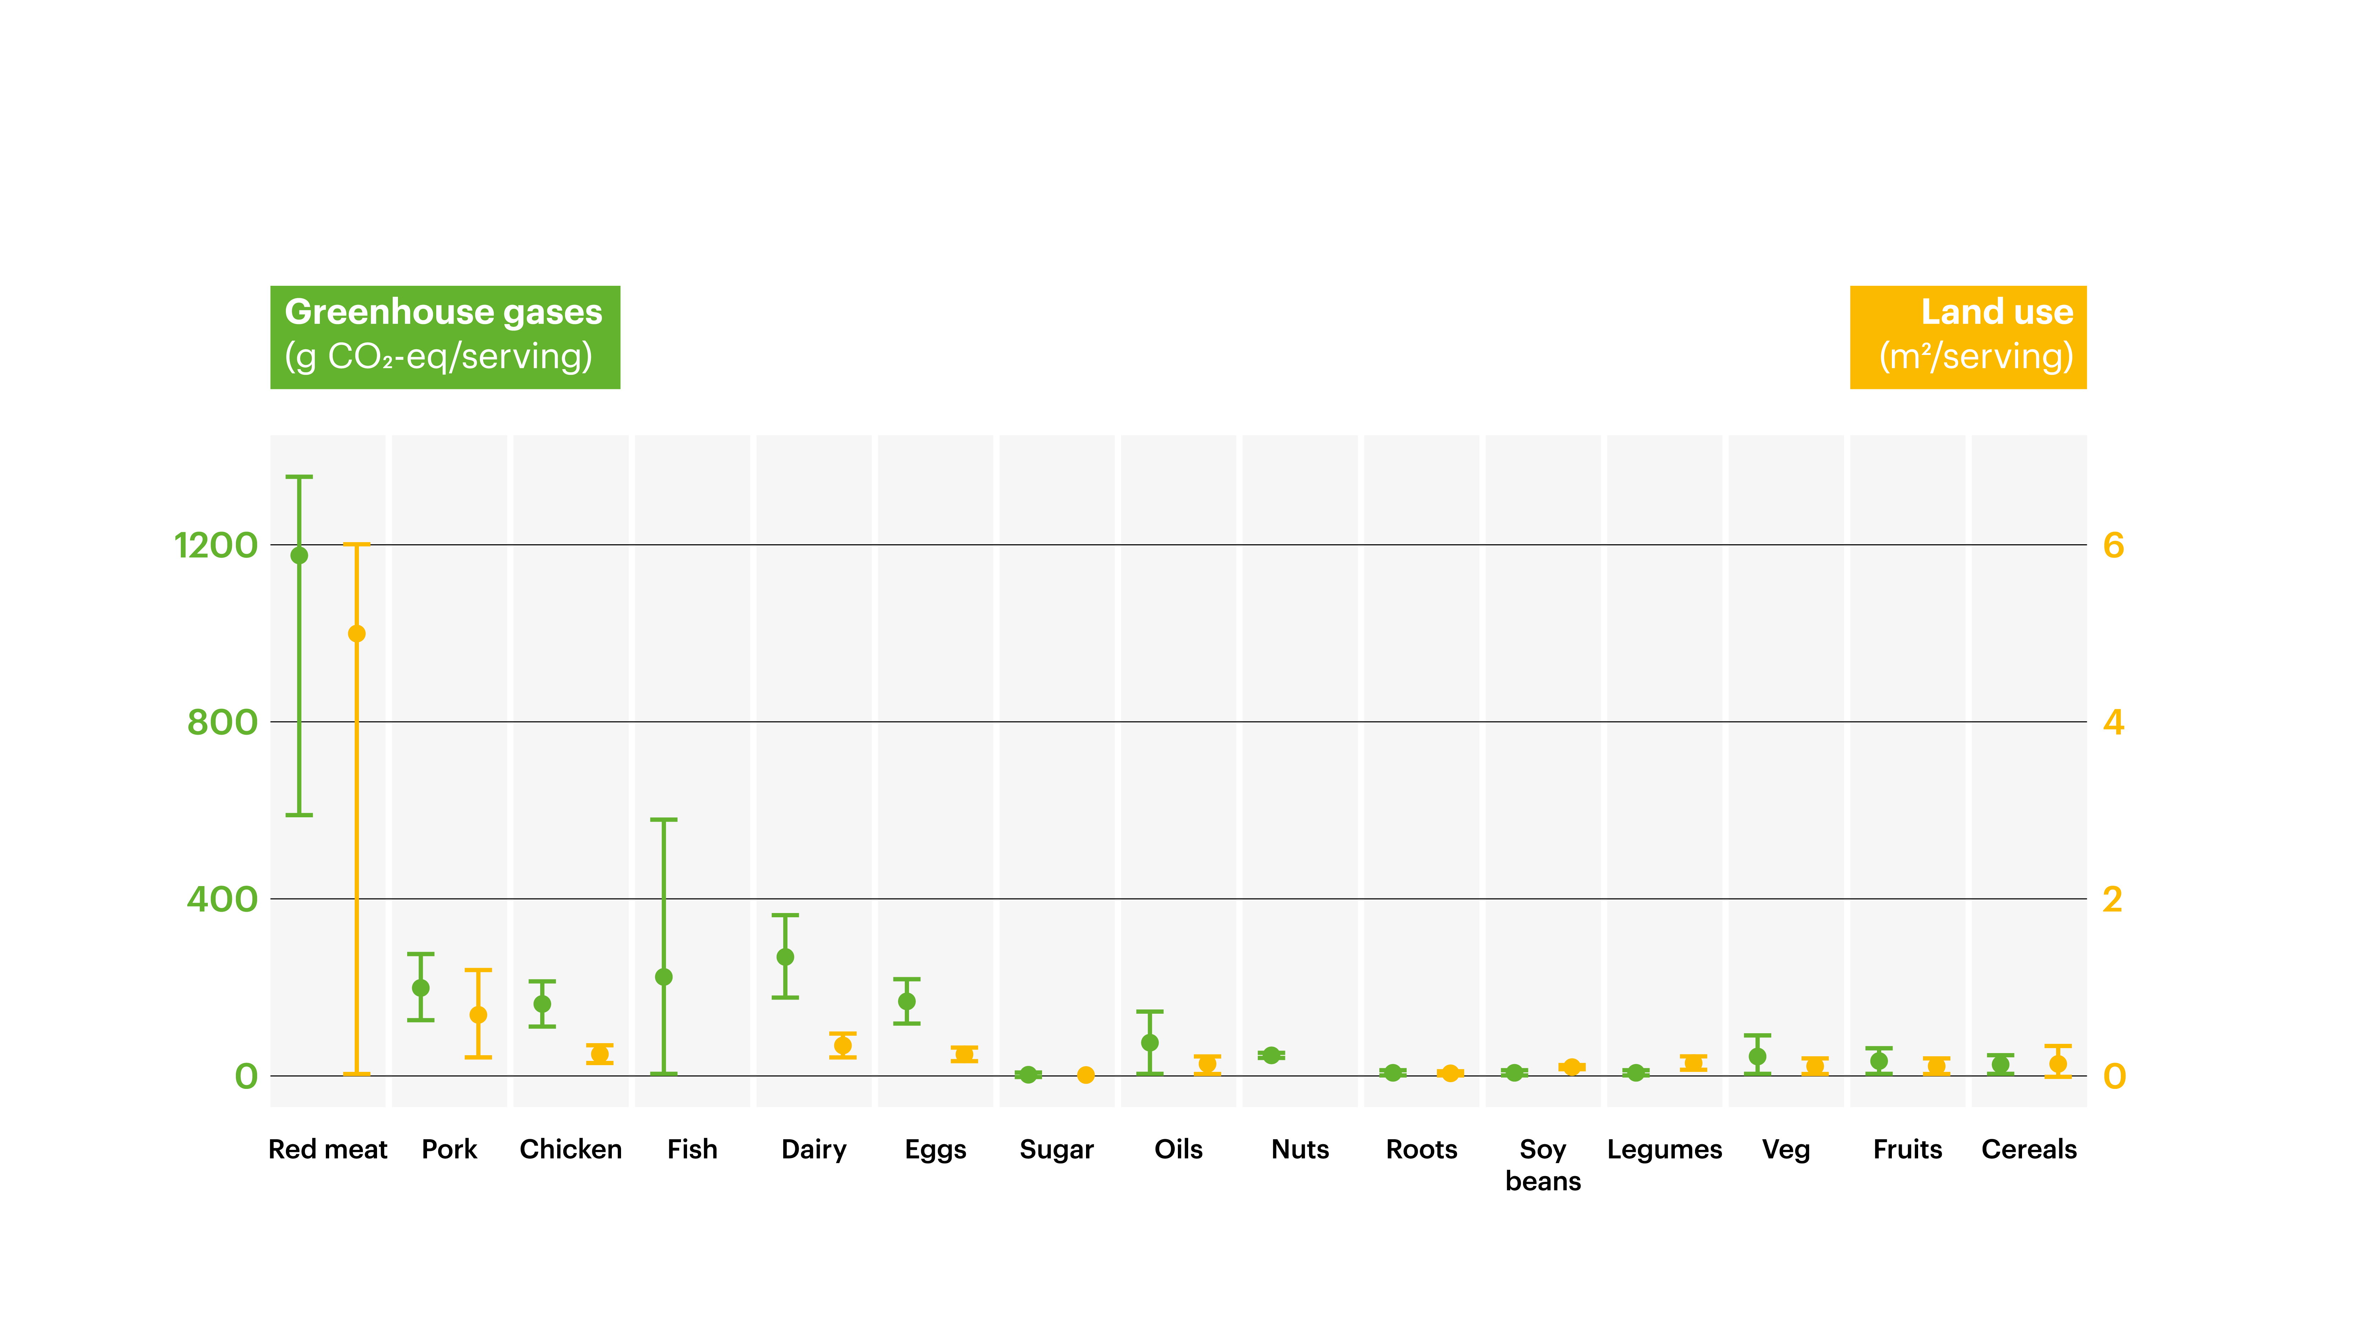
Environmental Effects per Serving of Food Produced
14.042

Slide 30
Scenarios for Control of Green House Gas Emission
Estimated Green House Gas Emissions (Gty)
Food Production Boundary 5.0
Baseline 2010 5.2
Business as Usual, 2050 9.8
Adopt Planetary Diet Targets 5.0
  + production improvement 4.4
  + 50% waste reduction 4.0
40.025

Slide 31
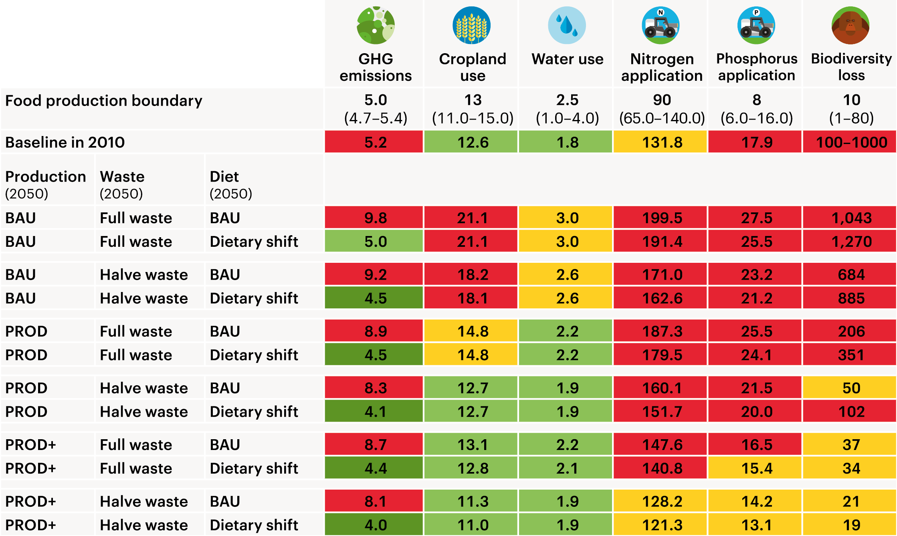
Scenarios
14.043

Slide 32
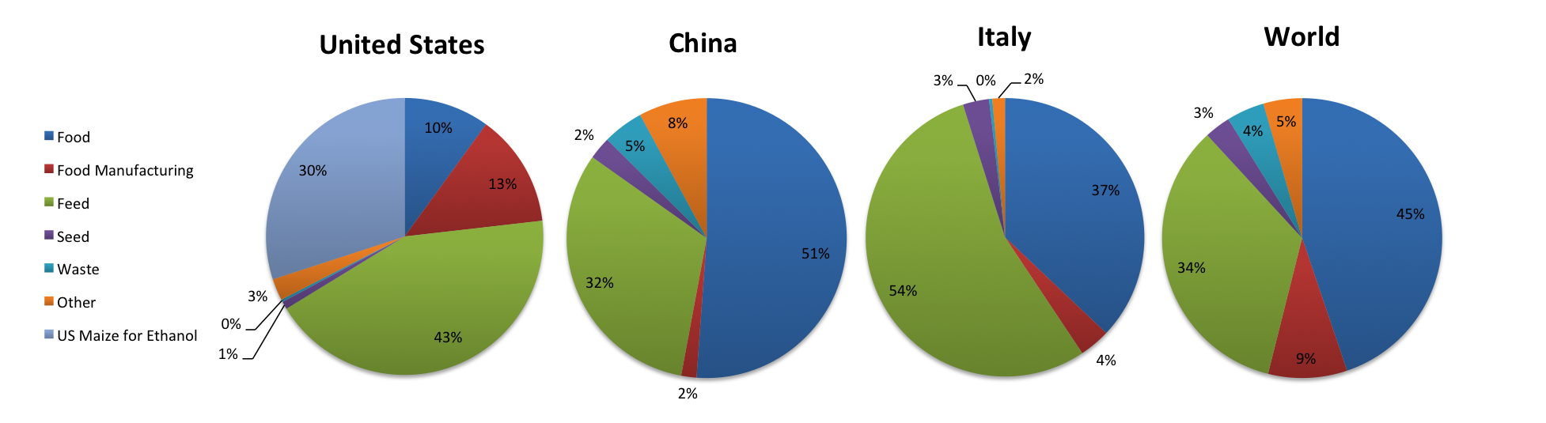
Domestic Uses of Grain in the US
29.621
http://faostat3.fao.org/home/E.

Slide 33
Domestic Uses of Grain in China
29.623
http://faostat3.fao.org/home/E.

Slide 34
2012 U.S. Crop Acreage
29.526

Slide 35
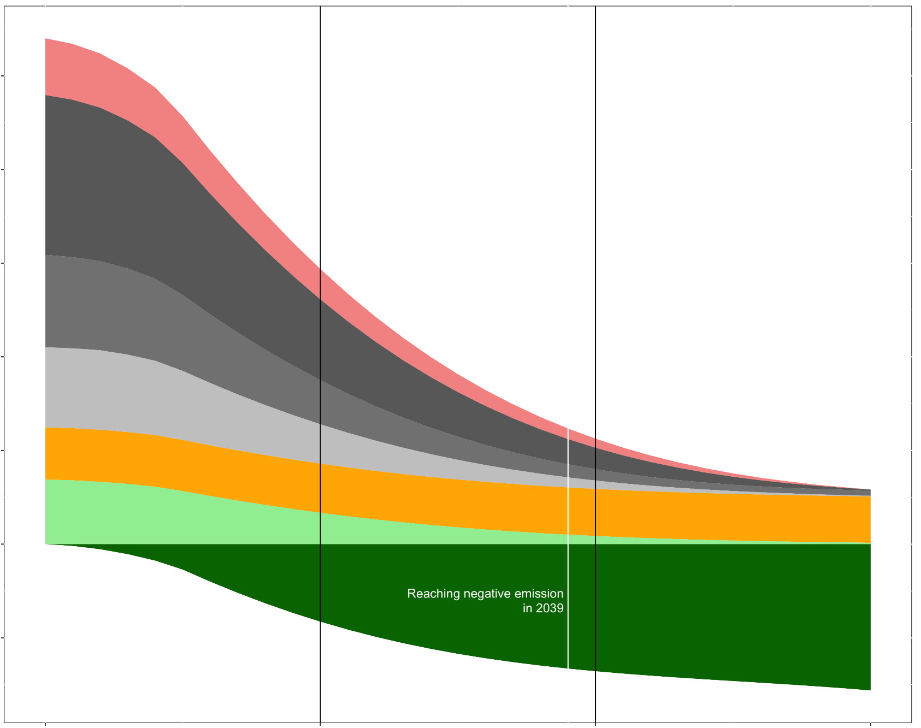
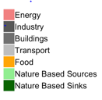
GHG Emissions: IPCC Path to less than 2º C Increase
50
40
30
Emission in Gt
20
Business as Usual
9.8 Gt from food
-4.8 with
EAT-Lancet
targets
10
}
5.7 Gt from food consumption
0
Reaching negative emissions
In 2039
-10
2020
2030
2040
2050
14.087

Slide 36
Implementation of Solutions
Supply vs Demand
Role of Policy and Regulation
40.019

Slide 37
Food Systems Changes (examples)
Change economic policies to make healthy, sustainable choices less expensive (e.g. internalize environmental costs of foods, eliminate indirect subsidies of unhealthy foods)
Policies that limit expansion of land use, restore natural habitats (e.g. land banking)
40.013

Slide 38
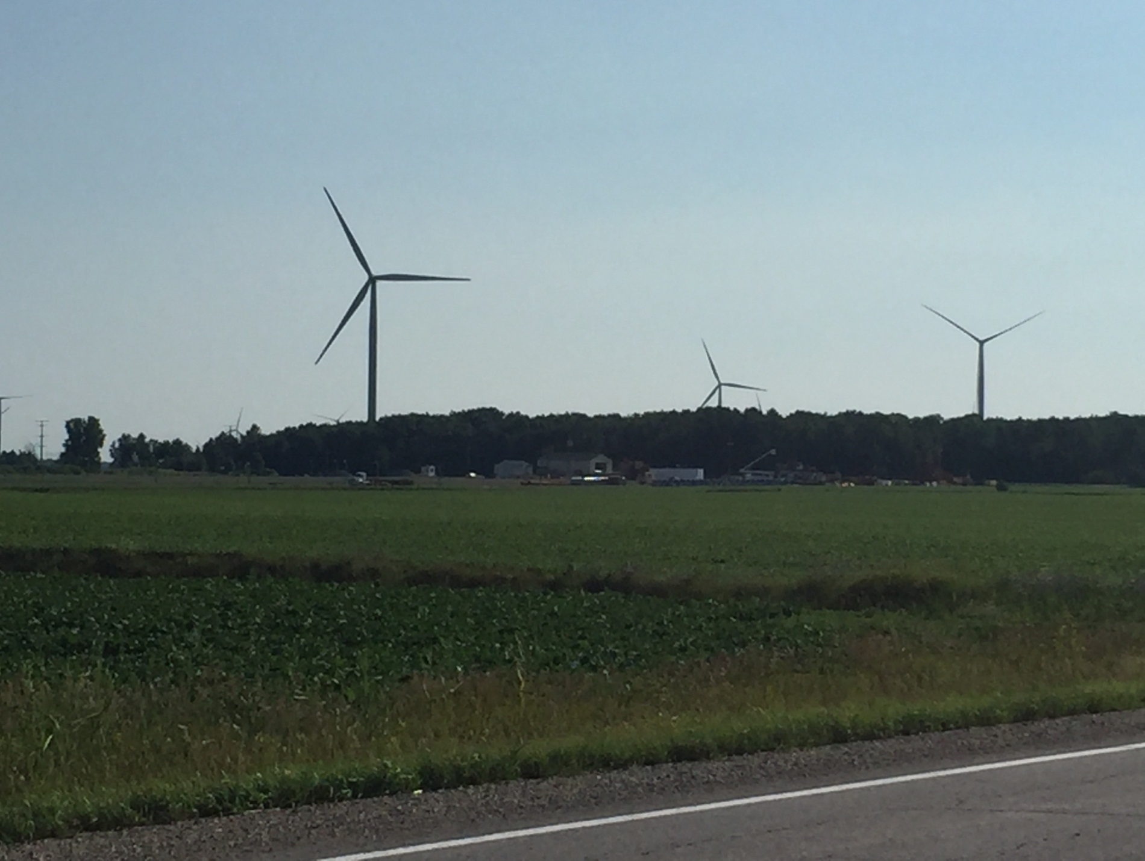
14.008

Slide 39

CONCLUSIONS
We are on a path leading to ecological disasters and a sick and unstable global population.
Feeding 10 billion people a healthy and sustainable diet is possible. This would improve the well-being of billions of people and allow us to pass onto our children a viable planet.
14.054a-FNCE

Slide 40
Solutions
Adoption of healthy, largely plant-based diet globally
  ?? Cultured meat, algeal protein and oil, insects, etc.
Reduction of food loss and waste
Carbon-neutral, sustainable intensification of agriculture
  Complete shift to green energy sources
  Precision agriculture (e.g. fertilizer, water)
  Closing yield gaps, new technologies
  No expansion of land for agriculture, preservation of fisheries
40.014

